Slide 1
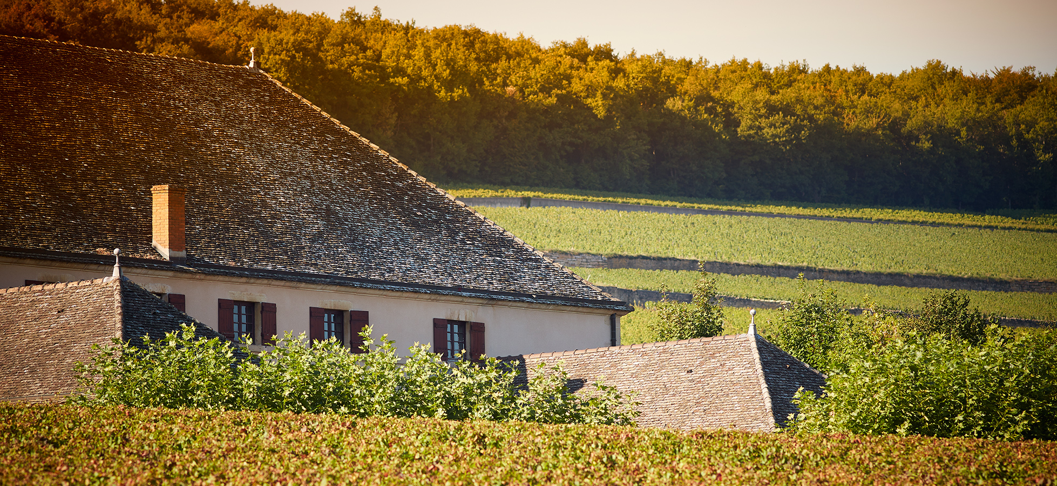
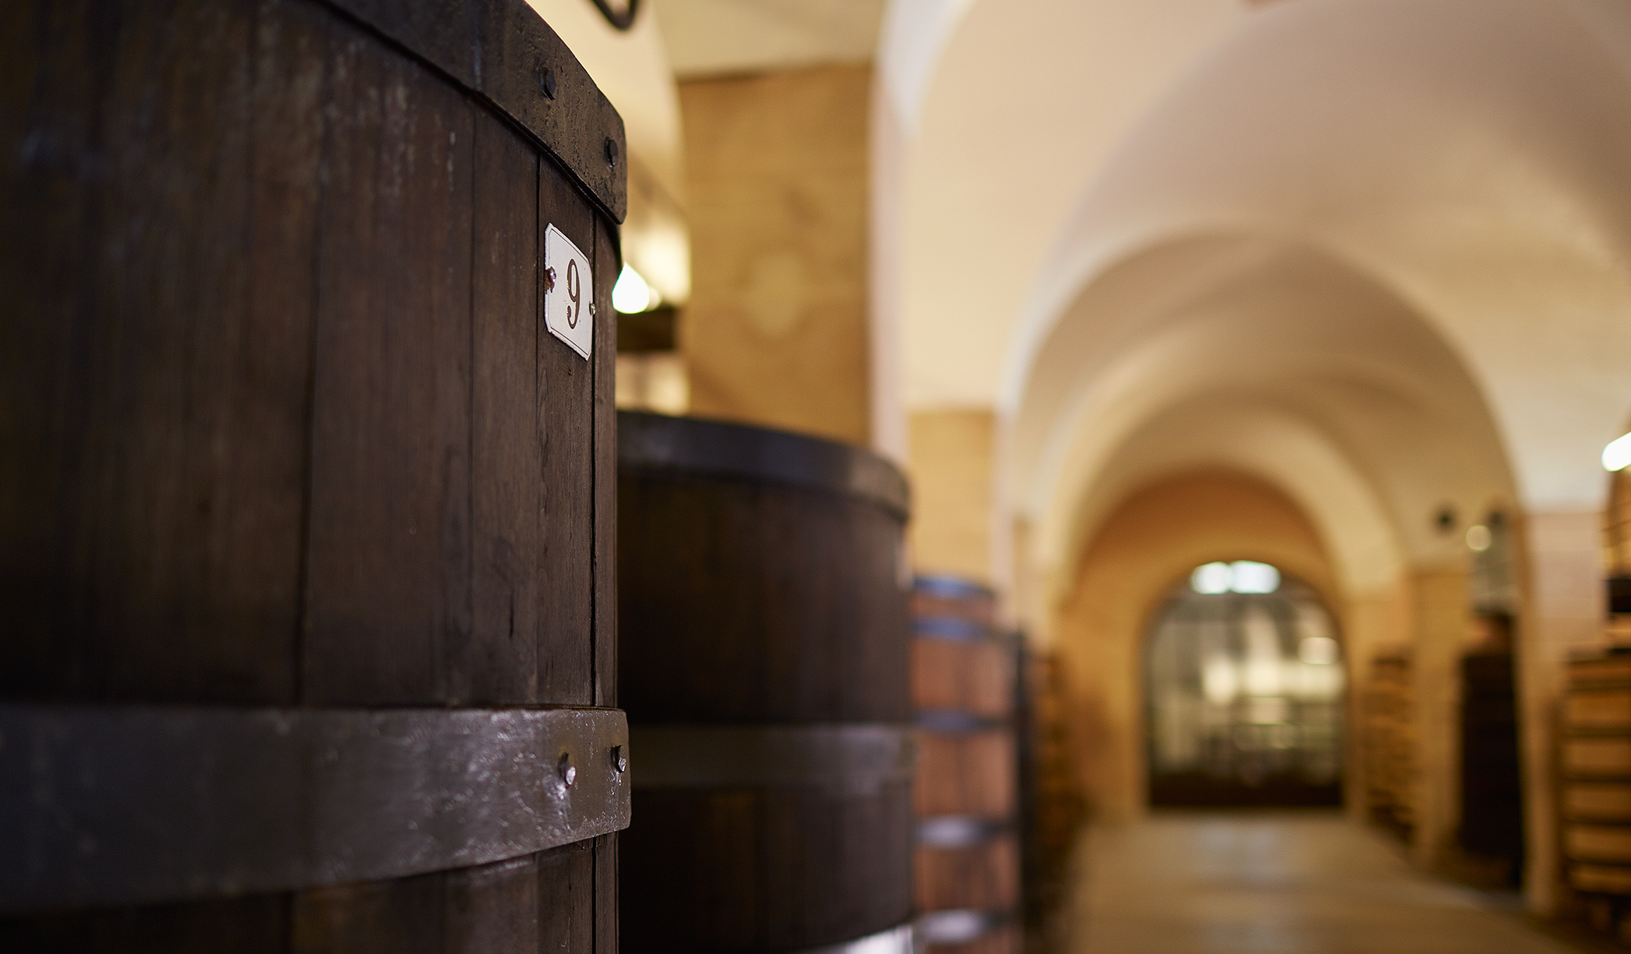
Maison Louis Latour
General Presentation

Slide 2
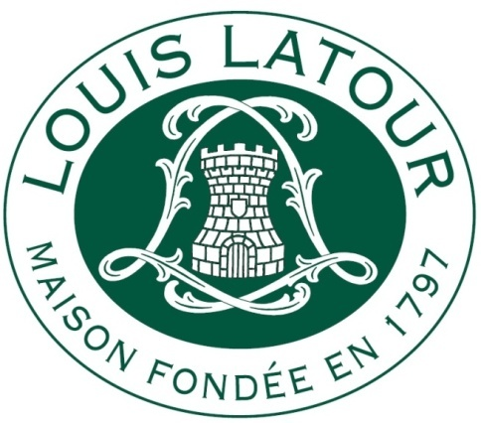
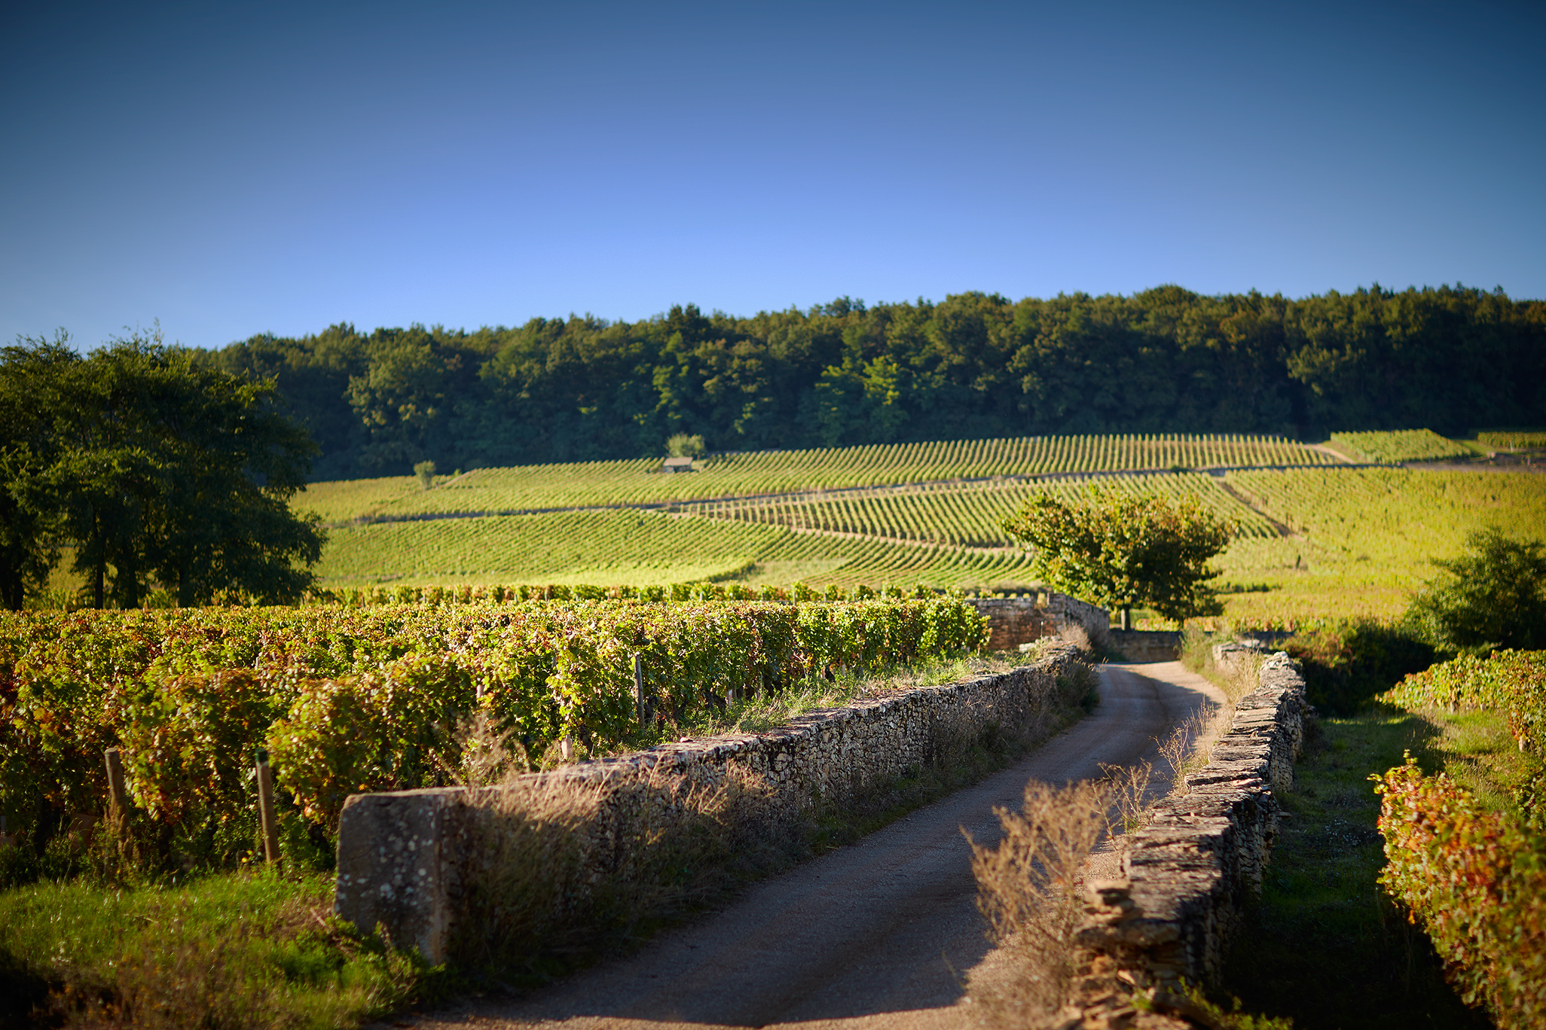
Table of contents
Maison Louis Latour – General Presentation
Location
Brief history
Grape varieties
Terroir
5 sub-regions
Maps
Key figures
The appellation system
1. Bourgogne

Slide 3
Location
Maison Louis Latour – General Presentation
Where is Louis Latour ?
In Bourgogne

Slide 4
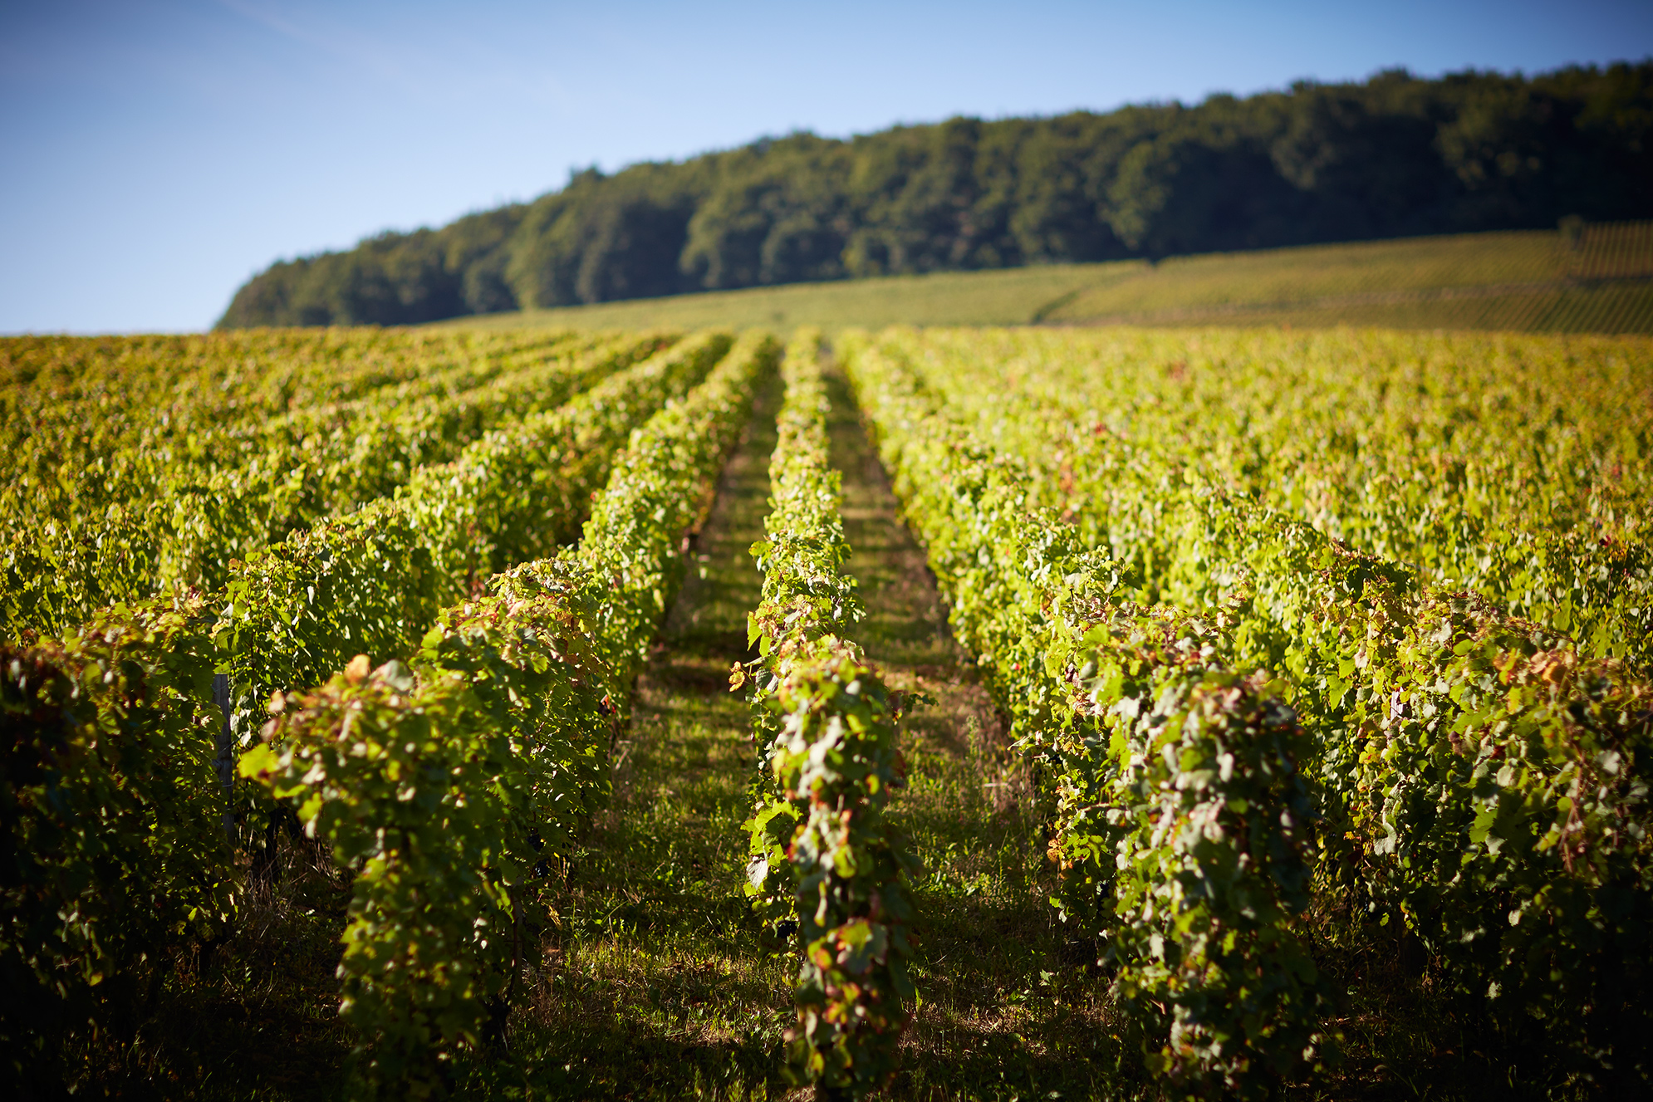
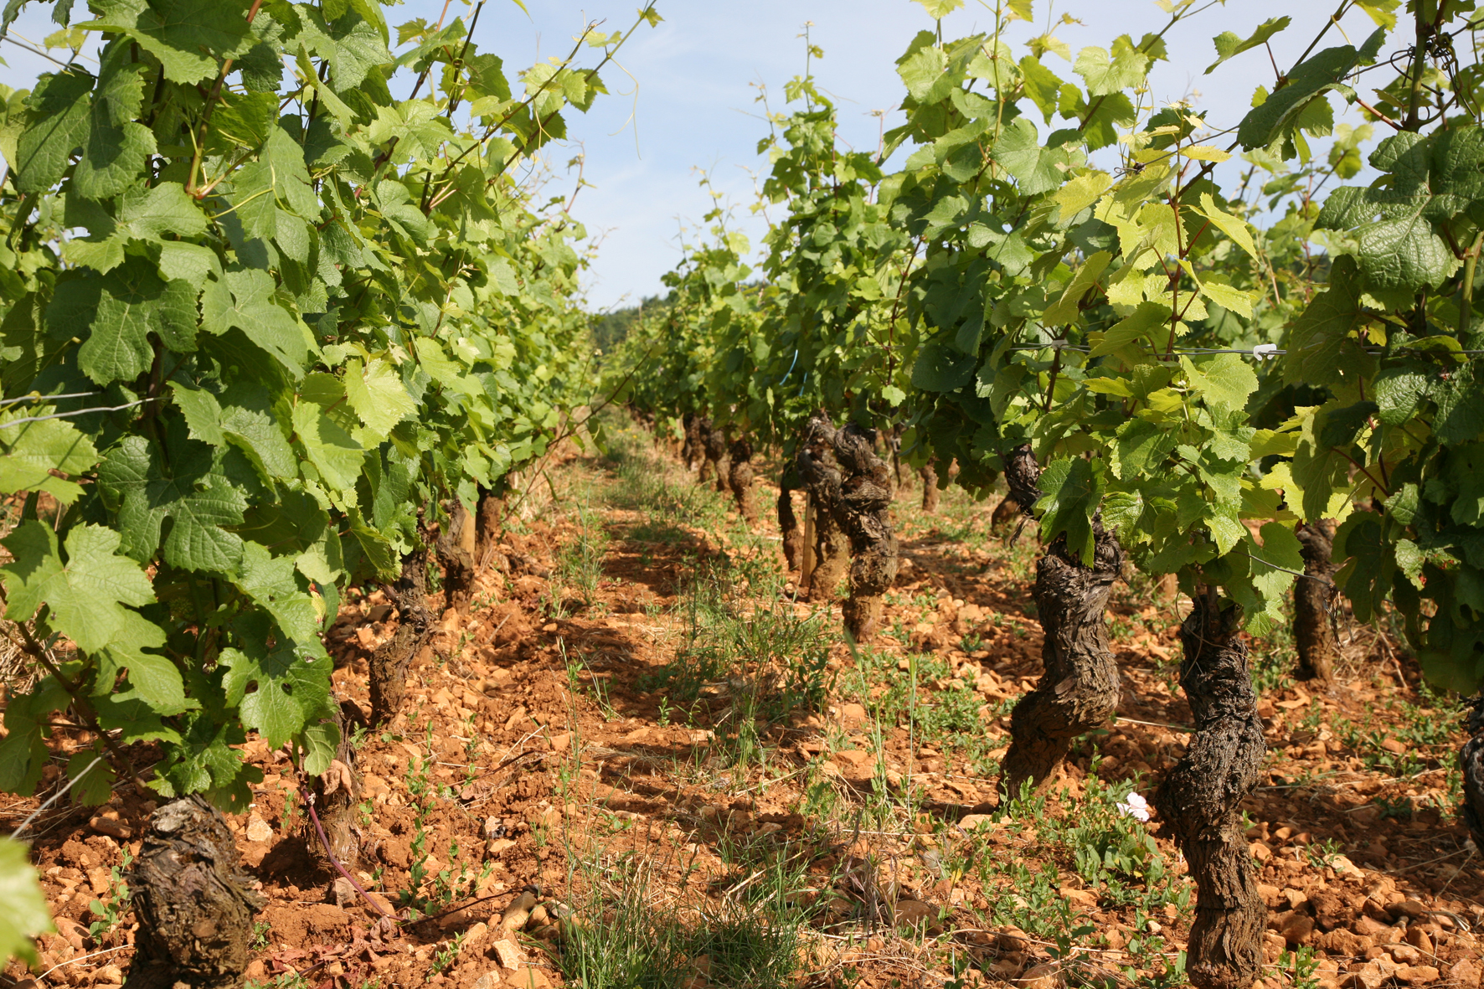
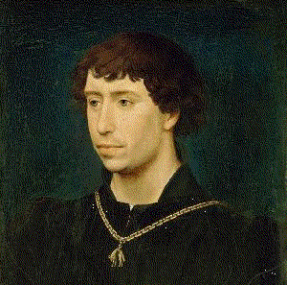
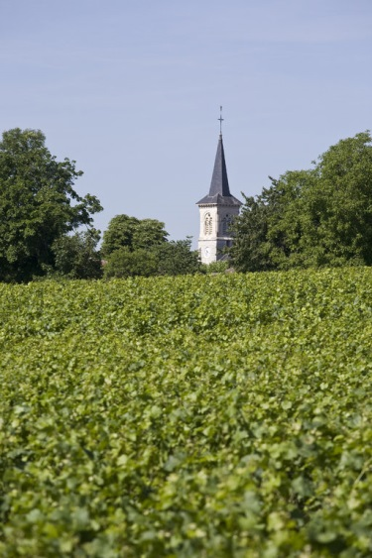
Brief History
Maison Louis Latour – General Presentation
-125
312
630
1395
1790
1797
The Romans and the Gauls started to grow vines.
First written records showing the presence of vineyards around Beaune.
The Monks began to study and cultivate vines and they created the notion of Terroir.
Philip le Hardy
favoured Pinot Noir as the
principal variety for burgundy
red.
The vineyards
were confiscated
from the church after the French
revolution, then
sold at auction.
Maison Louis
Latour was
founded in the
town of Aloxe-Corton.

Slide 5
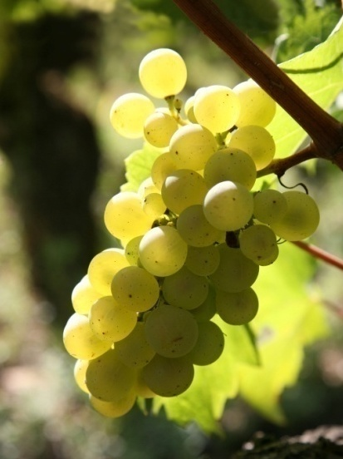
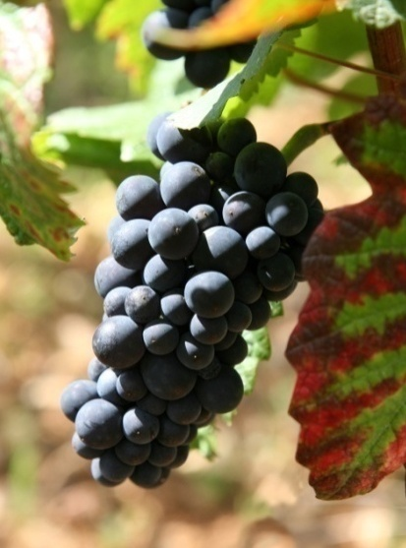
Grape varieties
Maison Louis Latour – General Presentation
All the Burgundy wines come from one of the following grape varieties:
Chardonnay for our white wines
Pinot Noir for our red wines
Other grape varieties:
Gamay is a red variety for Beaujolais and Bourgogne Gamay
Aligoté is a white variety which produces wine of the same name
César; Sauvignon Blanc, Pinot Blanc…
Chardonnay
Pinot Noir

Slide 6
Terroir
Maison Louis Latour – General Presentation
Terroir is the term used to describe all the natural elements which
characterize a vineyard:
Climate : Continental with cold winters and hot summers.
Lots of micro-climates which impact temperature, rainfall,
exposure to the wind, sunshine period…
1
Sedimentary soils : dating back to prior Jurassic period (180 million years).
Mainly composed of Limestone, Clay and Marl
2
Many others natural and human factors…
3
Location, Altitude, Exposure, Human actions…

Slide 7
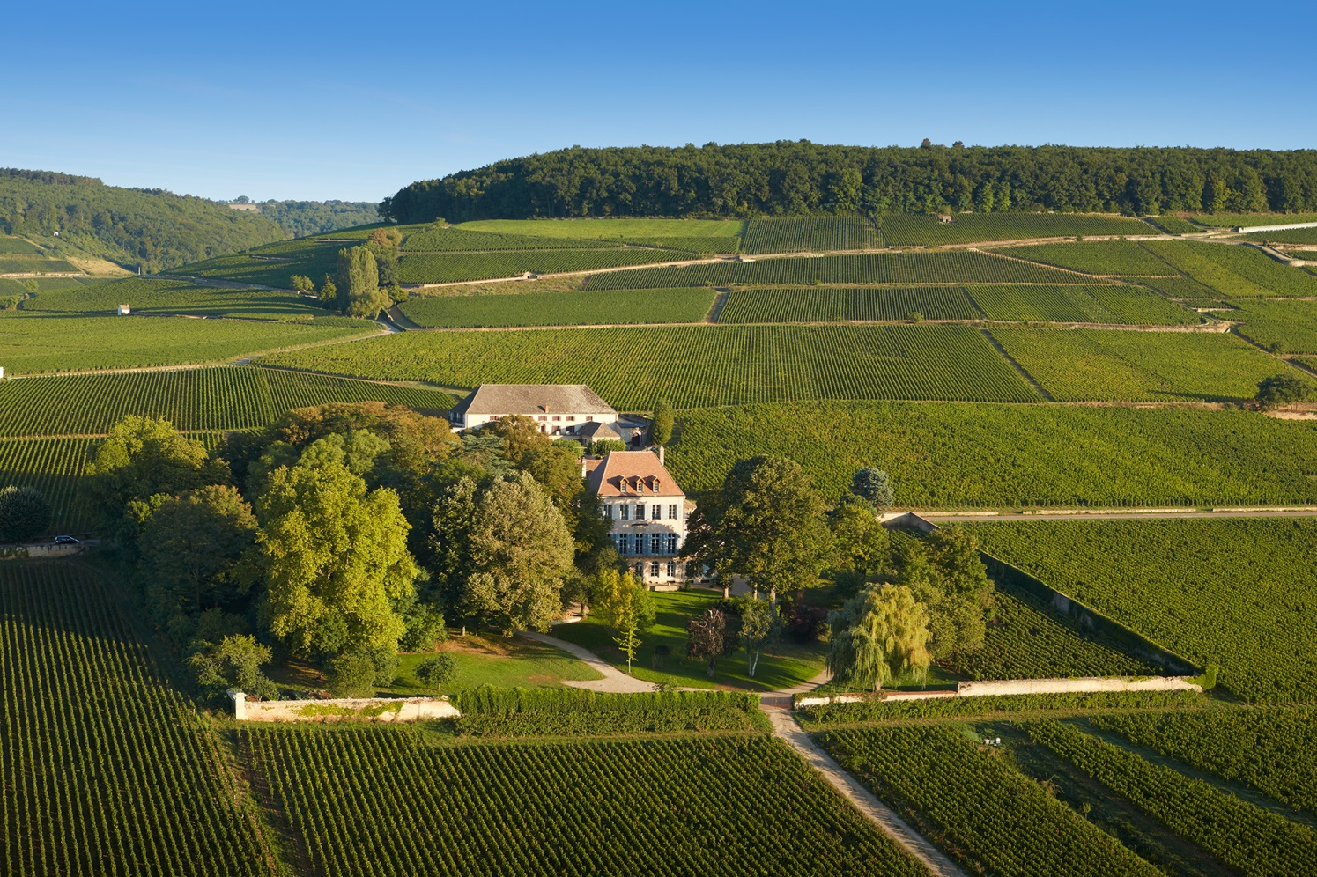
Terroir
Maison Louis Latour – General Presentation
Les Climats du vignoble de Bourgogne
Unesco World Heritage site: since July 2015.
An important guarantee for the sustainability of the ecosystem.
An important landmark for generations to come with a total of 1247 named Bourgogne vineyards known as the “Climats de Bourgogne”.
The hill of Corton: one of the four “outstanding landscapes” for the UNESCO recognition.
What’s a « climat » ?
Each Climat is a vine plot, with its own microclimate and specific geological conditions, which has been carefully marked out and named over the centuries. Each of them has its own story, produces wines with a distinct character and taste and keeps its own place in the hierarchy of Crus.
Corton is a symbol of the Burgundy « hillside viticulture » as Clos Vougeot is the symbole of « Clos viticulture ». The varied topography, different orientations and expositions cause climatics diversity on the hill.

Slide 8
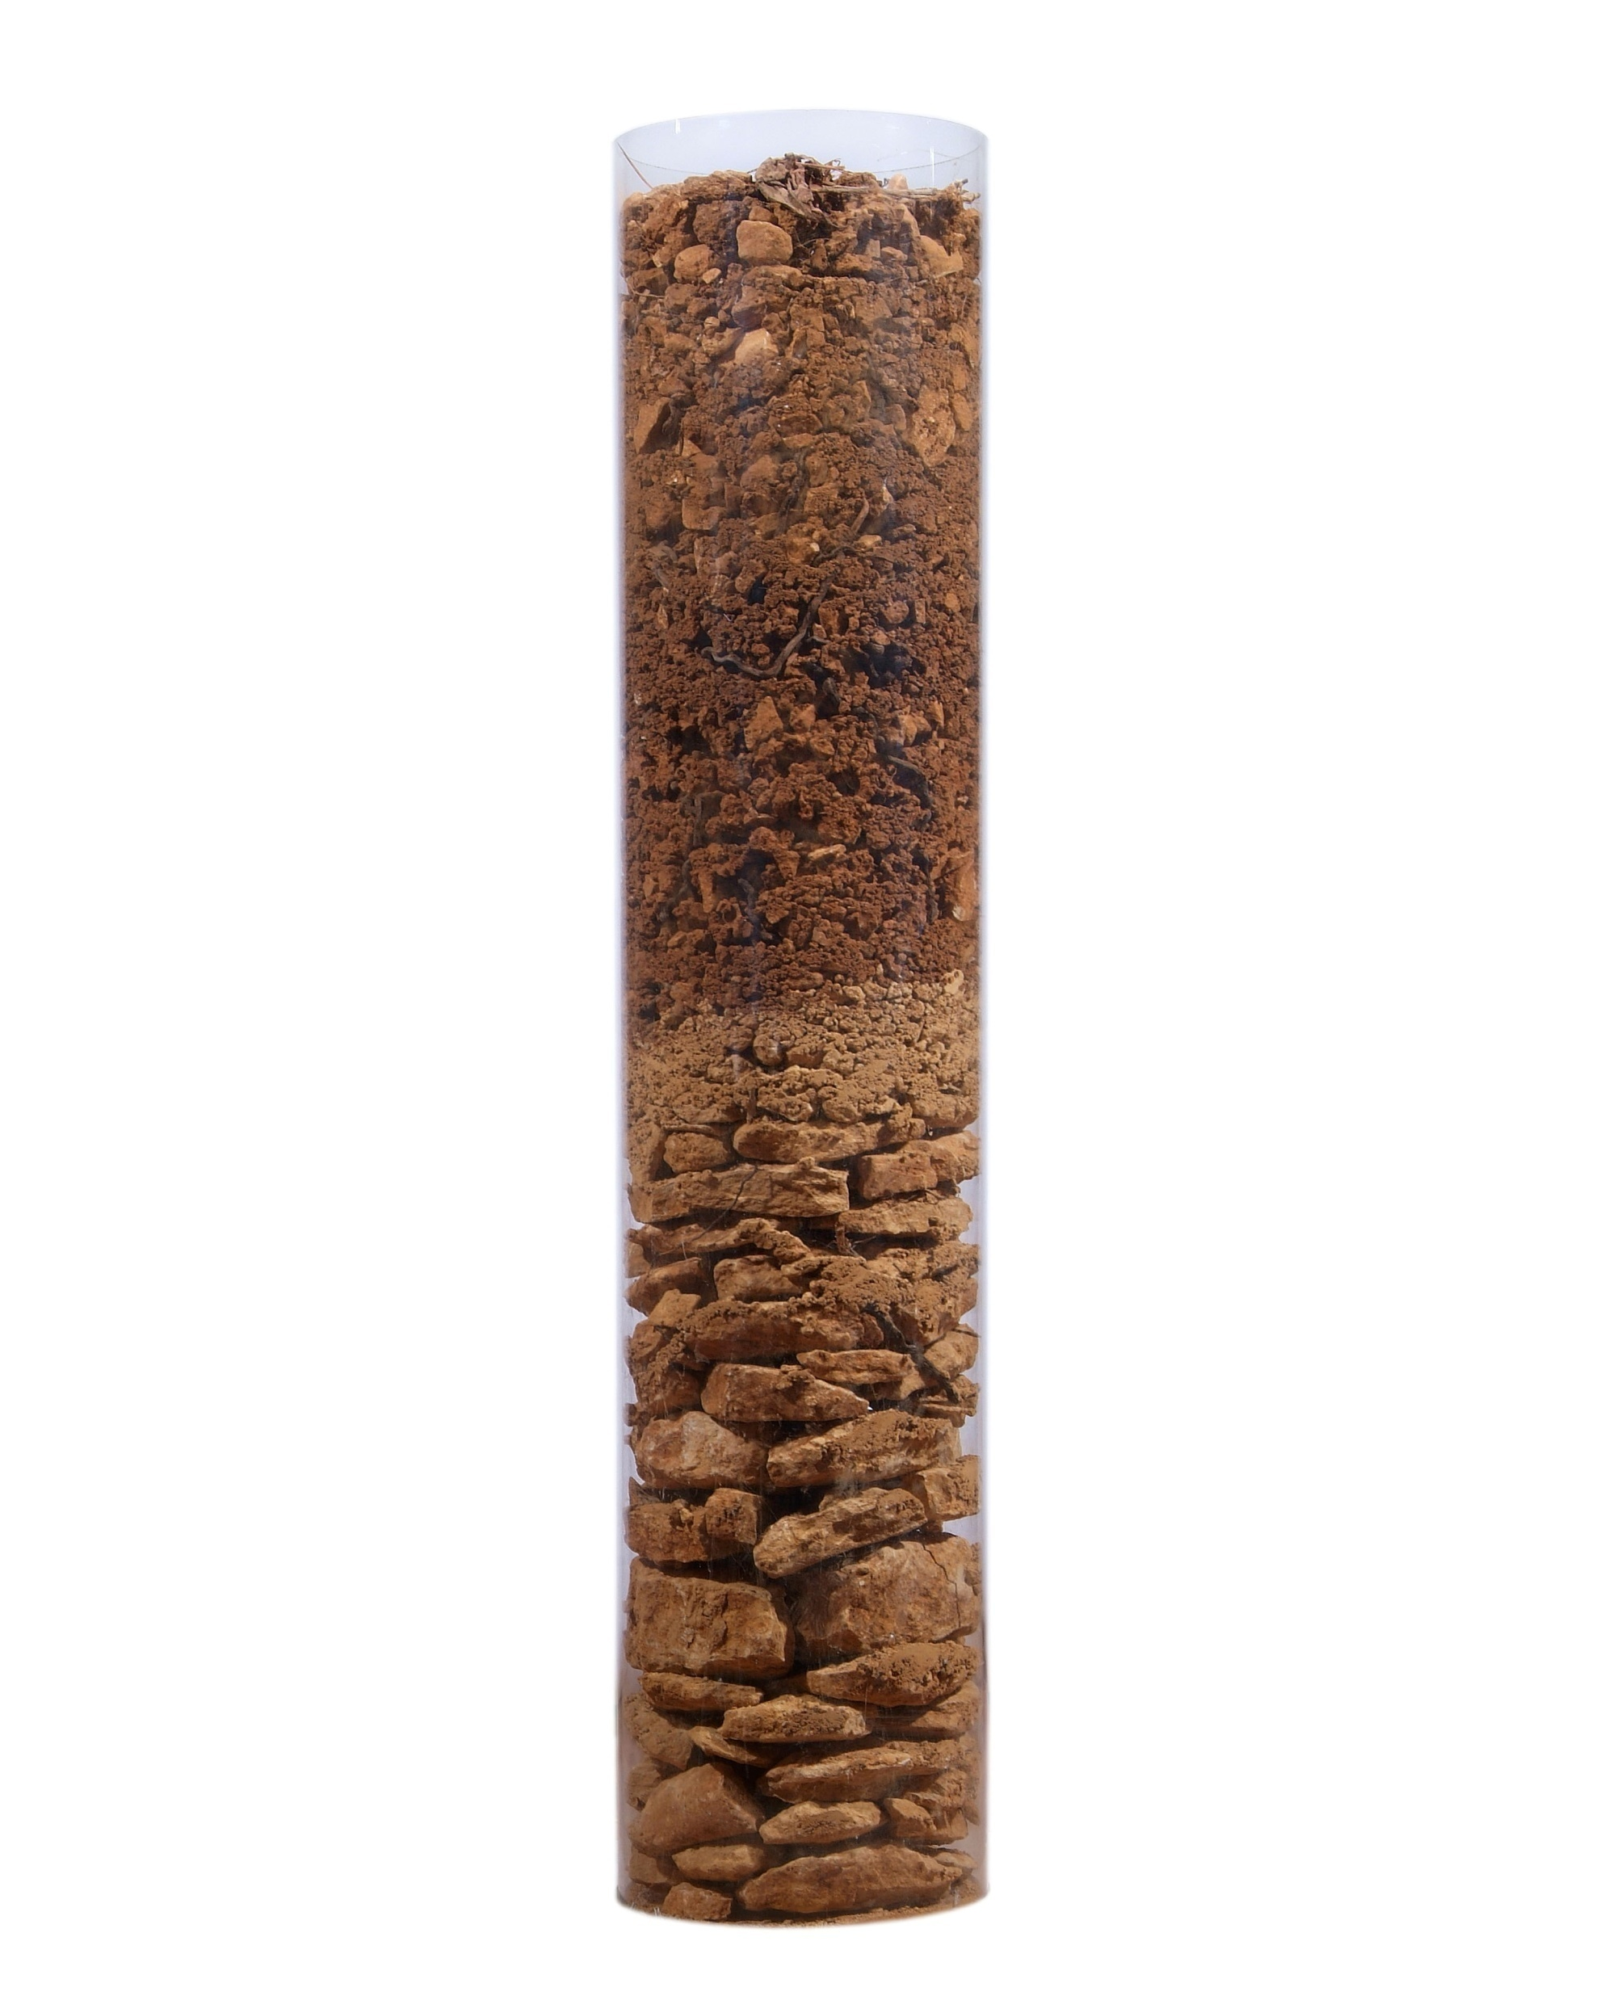
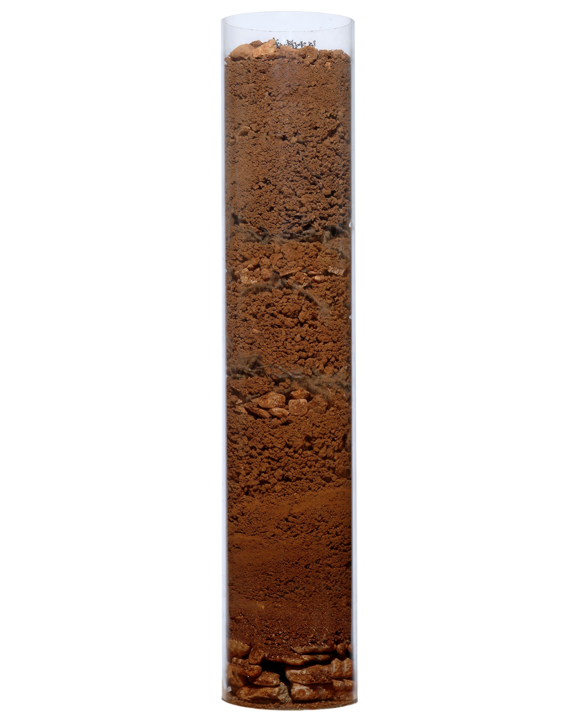
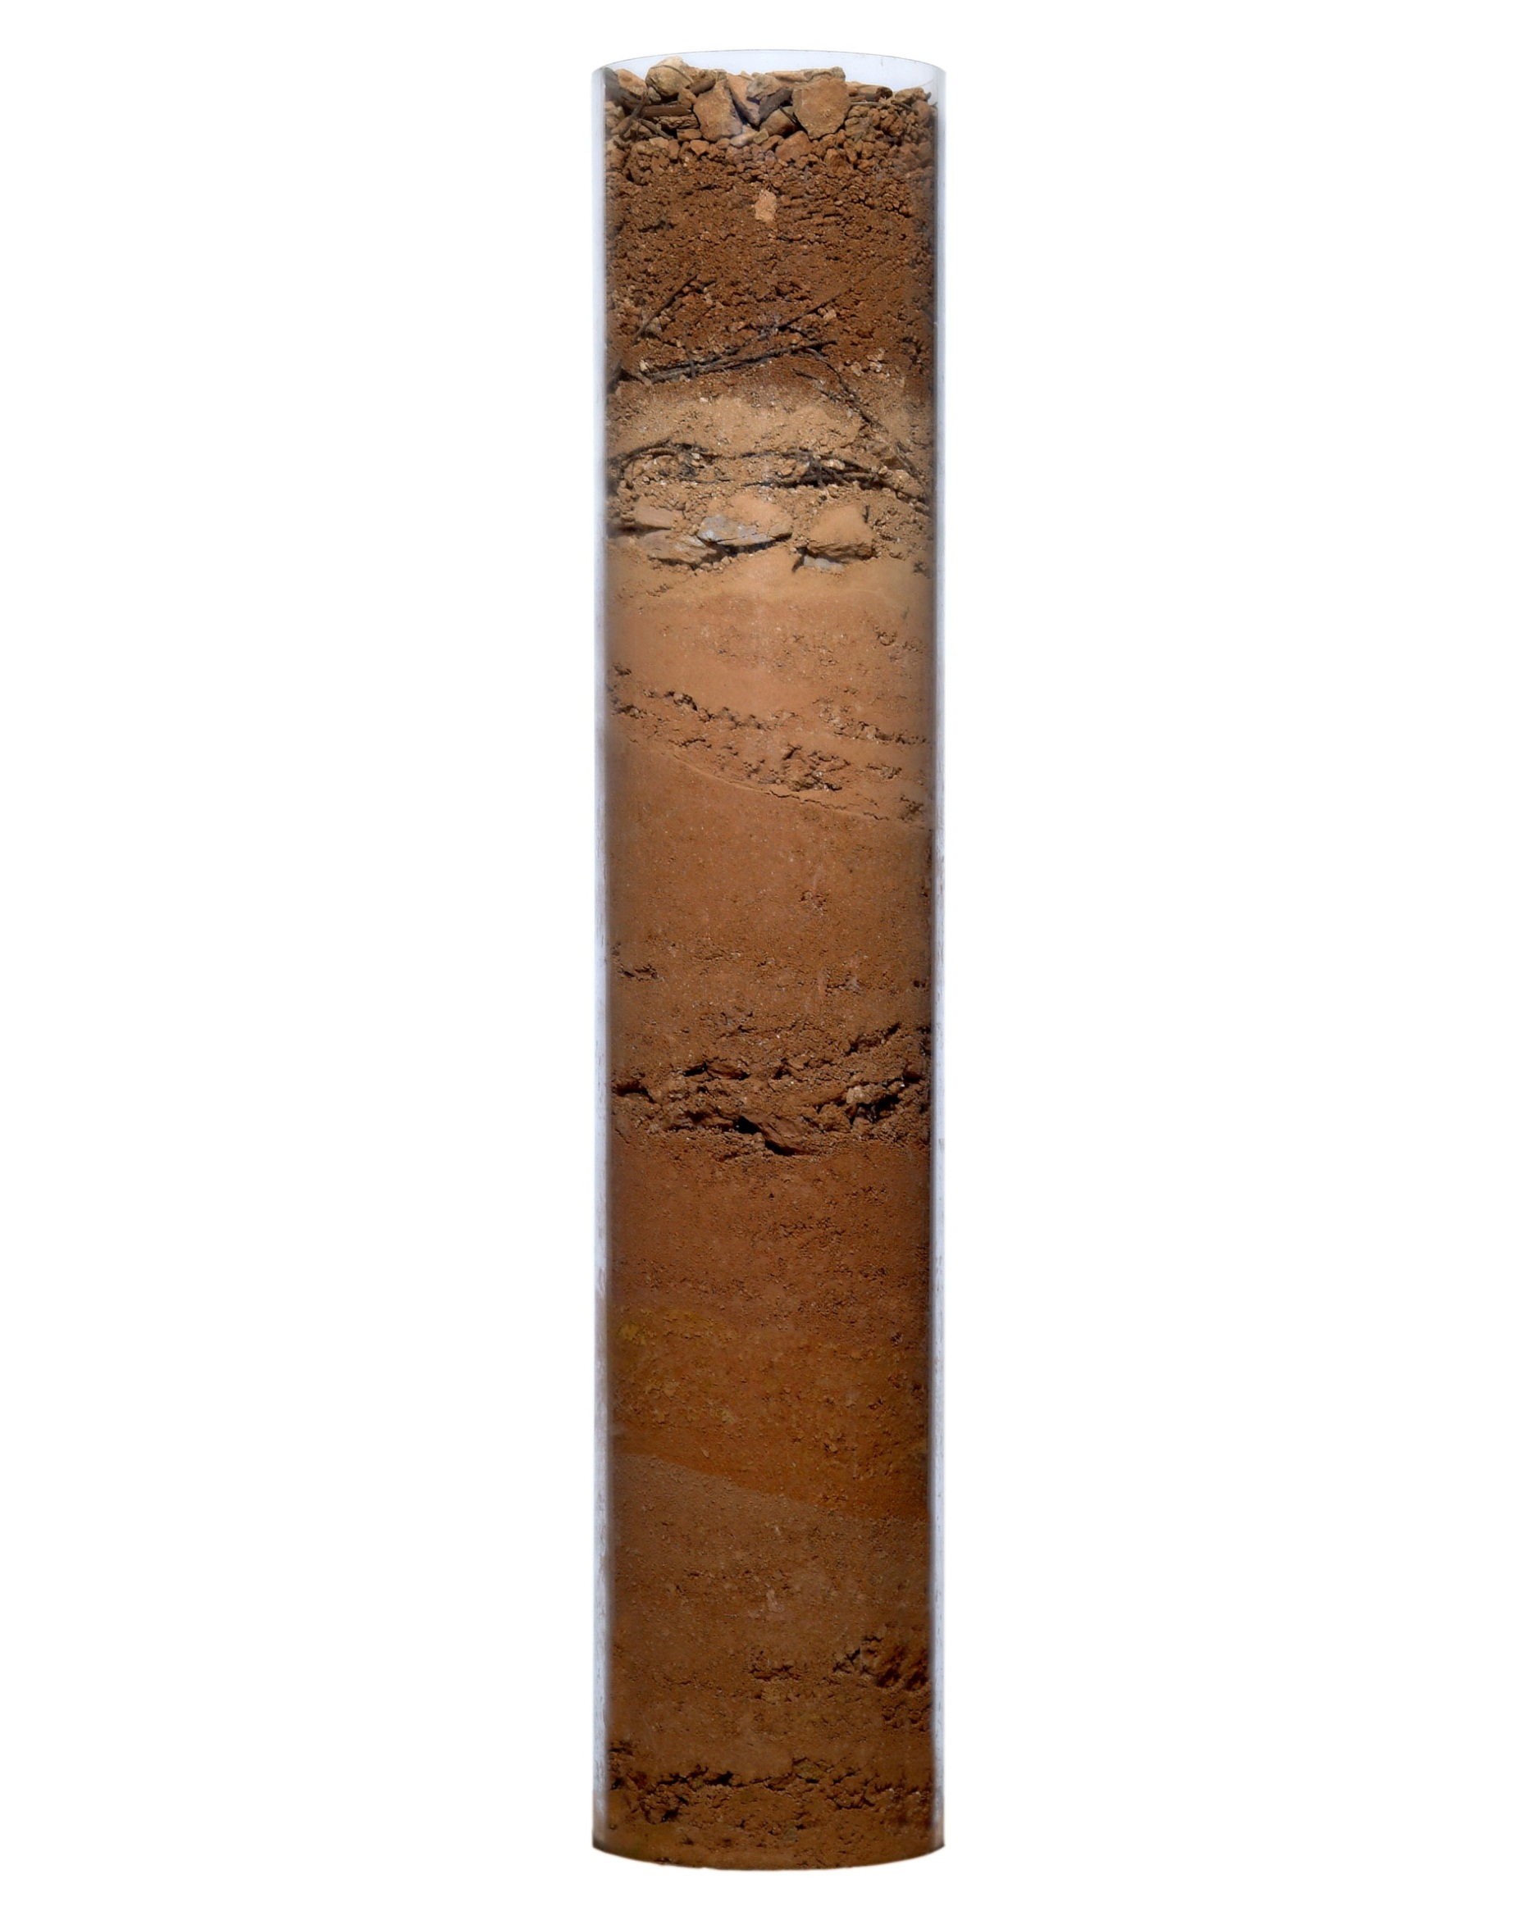
Terroir
Maison Louis Latour – General Presentation
Corton Perrières
South-East , 273 meters
Corton Bressandes
South-East, 250 meters
Clos de la Vigne au Saint
South, 2% slope, 240 meters
Corton Charlemagne
South, Southeast ; 10% slope, 320 meters
Soil:
Clay-limestone silt
Soil:
Clay-limestone silt
Soil:
Clay-limestone silt
Soil:
Clay-limestone silt
Limestone Layer
Limestone Layer
Bedrock:
Calcareous marls and fine limestone
Bedrock:
Mid-Jurassic
Bedrock:
Mid-Jurassic
limestone
Bedrock:
Small sharp limestone, rocks from dry valley beds

Slide 9
Terroir
Maison Louis Latour – General Presentation
Dates of harvest since 1925 :

Slide 10
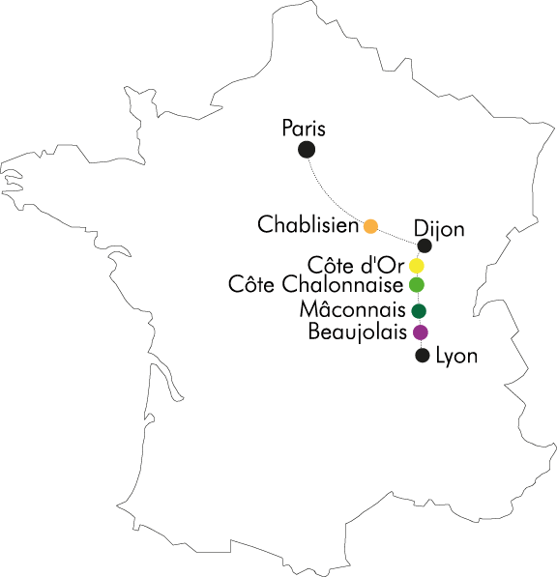
5 sub-regions
Maison Louis Latour – General Presentation
Burgundy is split into
5 main sub-regions:
Chablis
Côte d’Or
(Côte de Nuits & Côte de Beaune)
Côte Chalonnaise
Mâconnais
Beaujolais

Slide 11
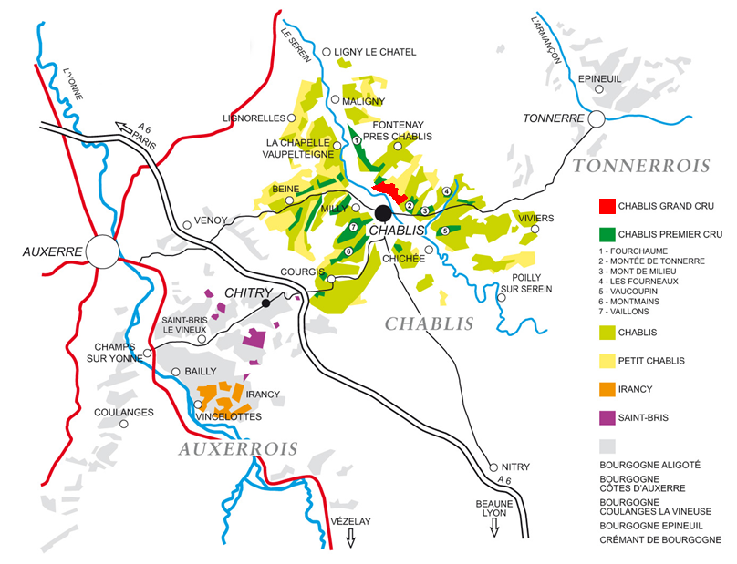
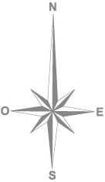
Map - Chablis
Maison Louis Latour – General Presentation

Slide 12
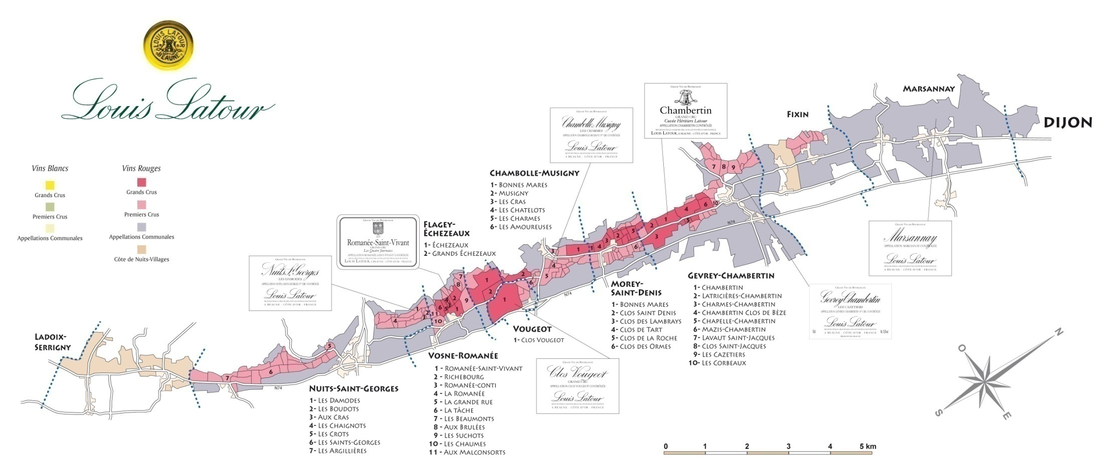
Map - Côte de Nuits
Maison Louis Latour – General Presentation

Slide 13
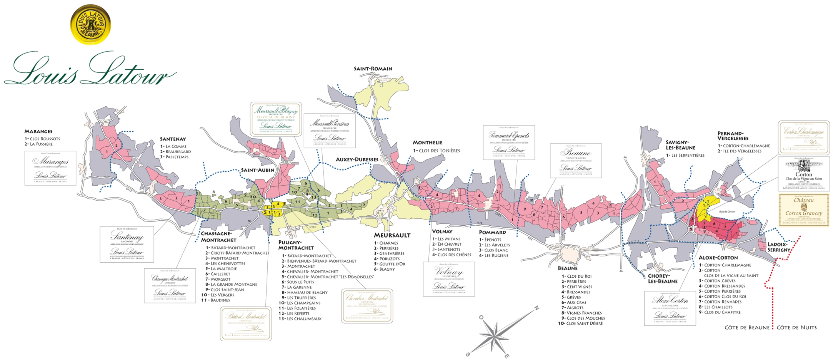
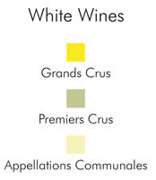
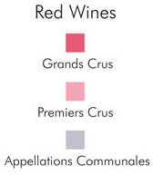
Map - Côte de Beaune
Maison Louis Latour – General Presentation

Slide 14
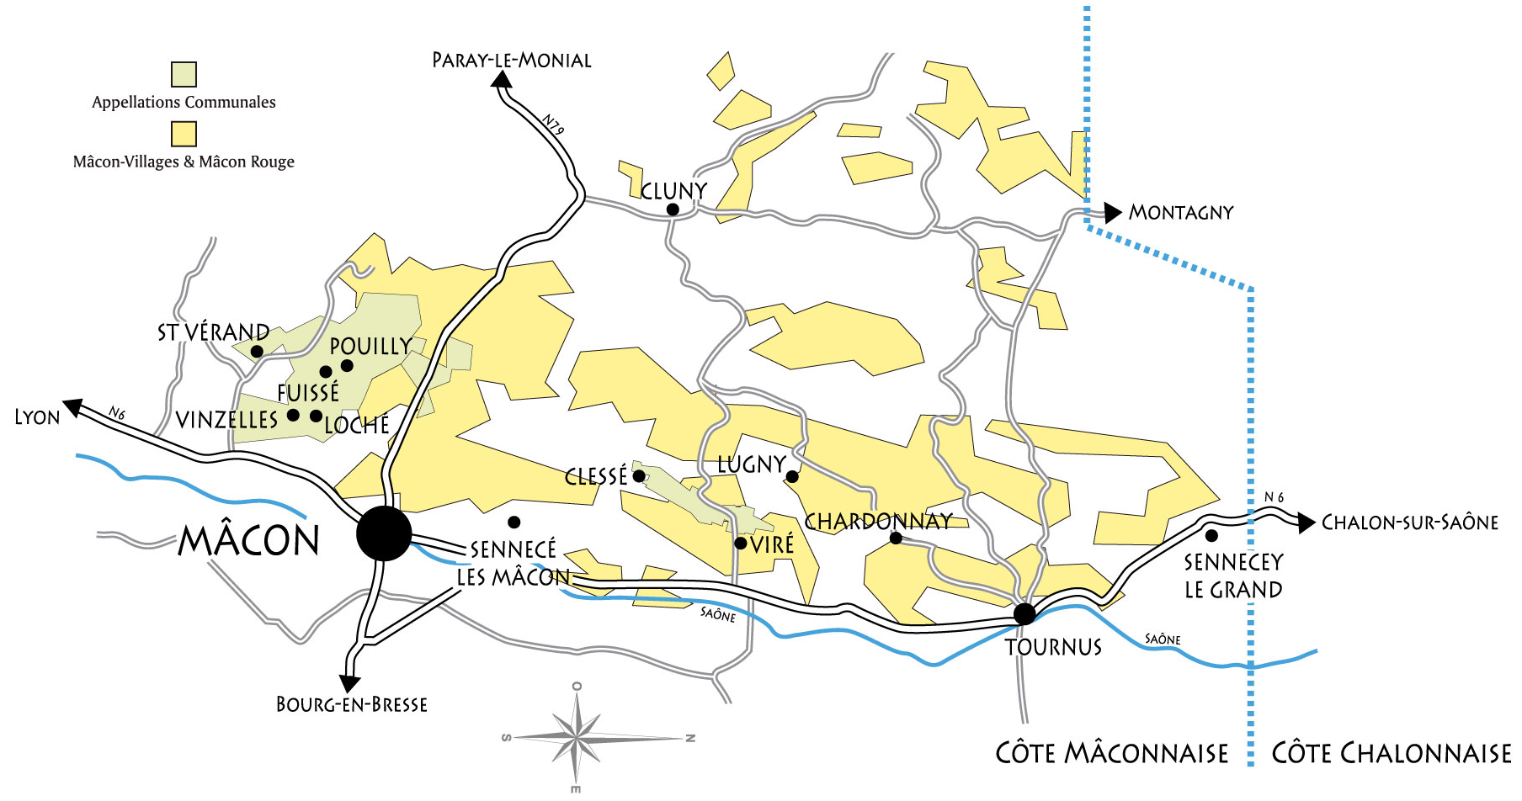
Map – Côte Chalonnaise et Côte Mâconnaise
Maison Louis Latour – General Presentation

Slide 15
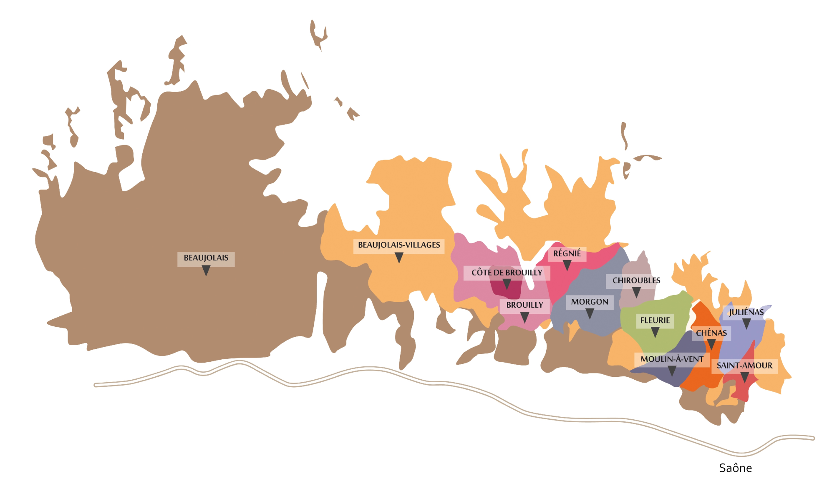
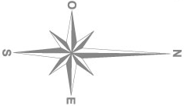
Map – Beaujolais
Maison Louis Latour – General Presentation

Slide 16
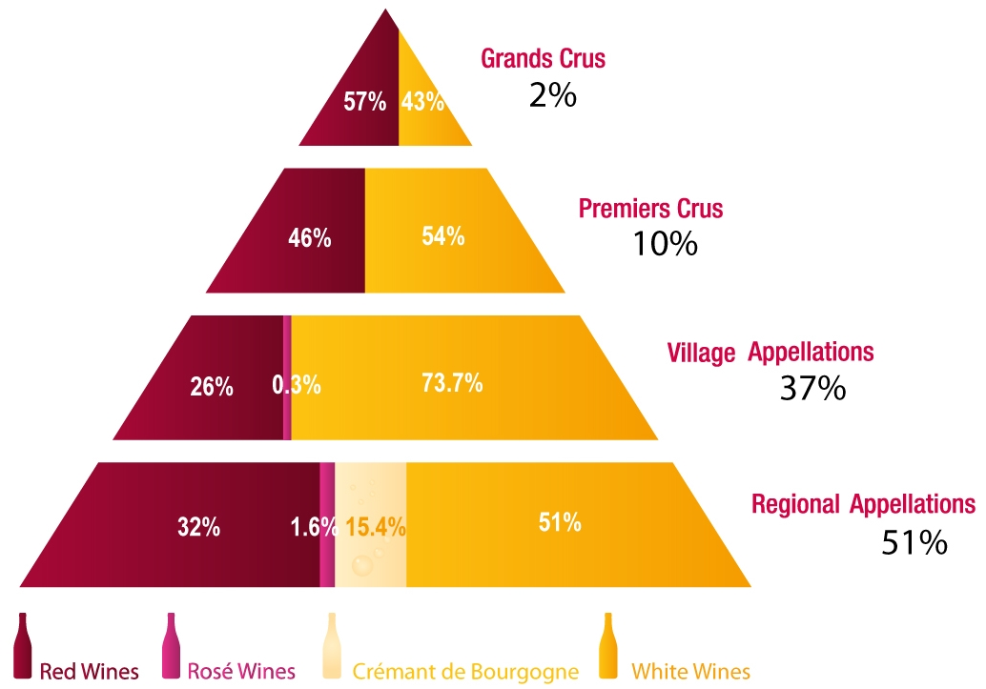
The appellation system
Maison Louis Latour – General Presentation
4 quality levels:
Burgundy has its own appellation system
New Appellations:
Bourgogne Gamay
BGO → Côteaux Bourguignons

Slide 17
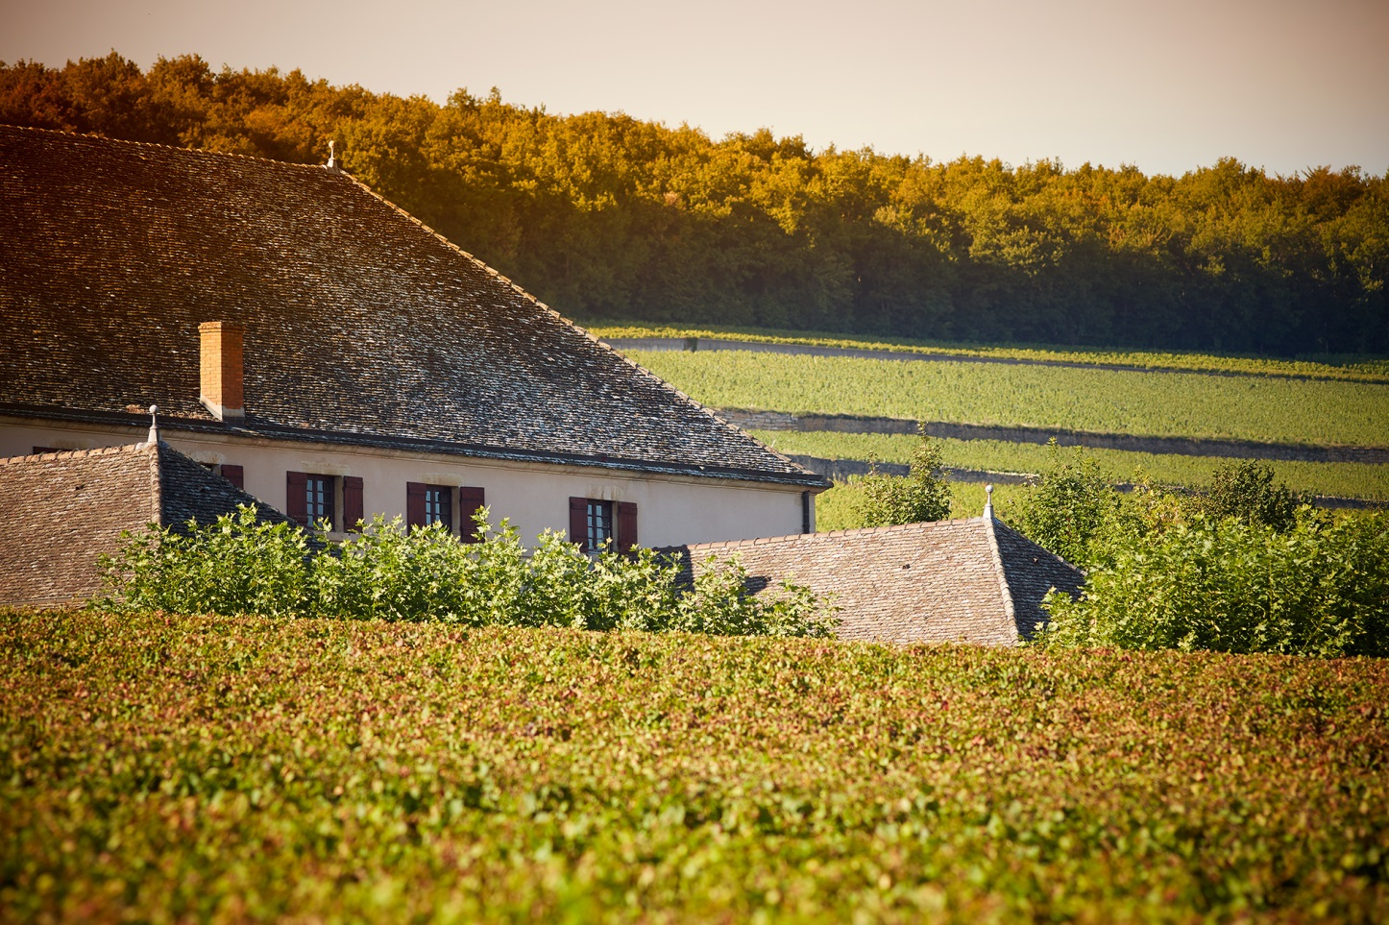
Table of contents
Maison Louis Latour – General Presentation
Three words say all :
Tradition
Louis Latour Family
Our wines
Our Domaine wines
Innovation
Ardèche
Domaine de Valmoissine Les Pierres Dorées
Simonnet-Febvre, Chablis
Henry Fessy, Beaujolais Perfection
Sustainable farming
Vine selection
Winemaking of our red wines
Winemaking of our white wines
Louis Latour in 9 points
2. Maison Louis Latour

Slide 18
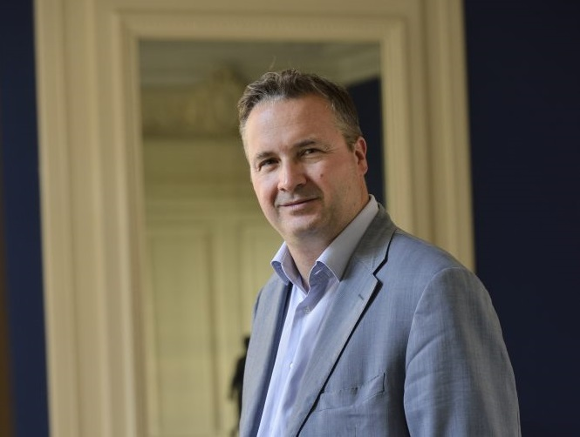
Tradition – Louis Latour Family
Maison Louis Latour – General Presentation
Tradition
Louis Latour Family
Founded in 1797
Louis-Fabrice Latour, 11th generation, owner and CEO
Domaine Louis Latour: 48 hectares including 27 of Grands Crus
Largest owner and seller of Grand Cru wines in Burgundy
Highly respected brand
In house Printer & Cooperage
An historic range of more than 130 Appellations
Notes:
On the middle South-eastern Segment (Aloxe), the wines are richer and have more power due to the more favorable orientation.
It’s the same thing at Pernand-Vergelessesbut. But, the forest on the upper-slope of Corton protect vines against Northeast wind ! At Pernand-Vergelesses, no forest, so the vines on the upper-slope have some difficulties to ripe (it’s why, we find here Village anf no Premier Cru).

Slide 19
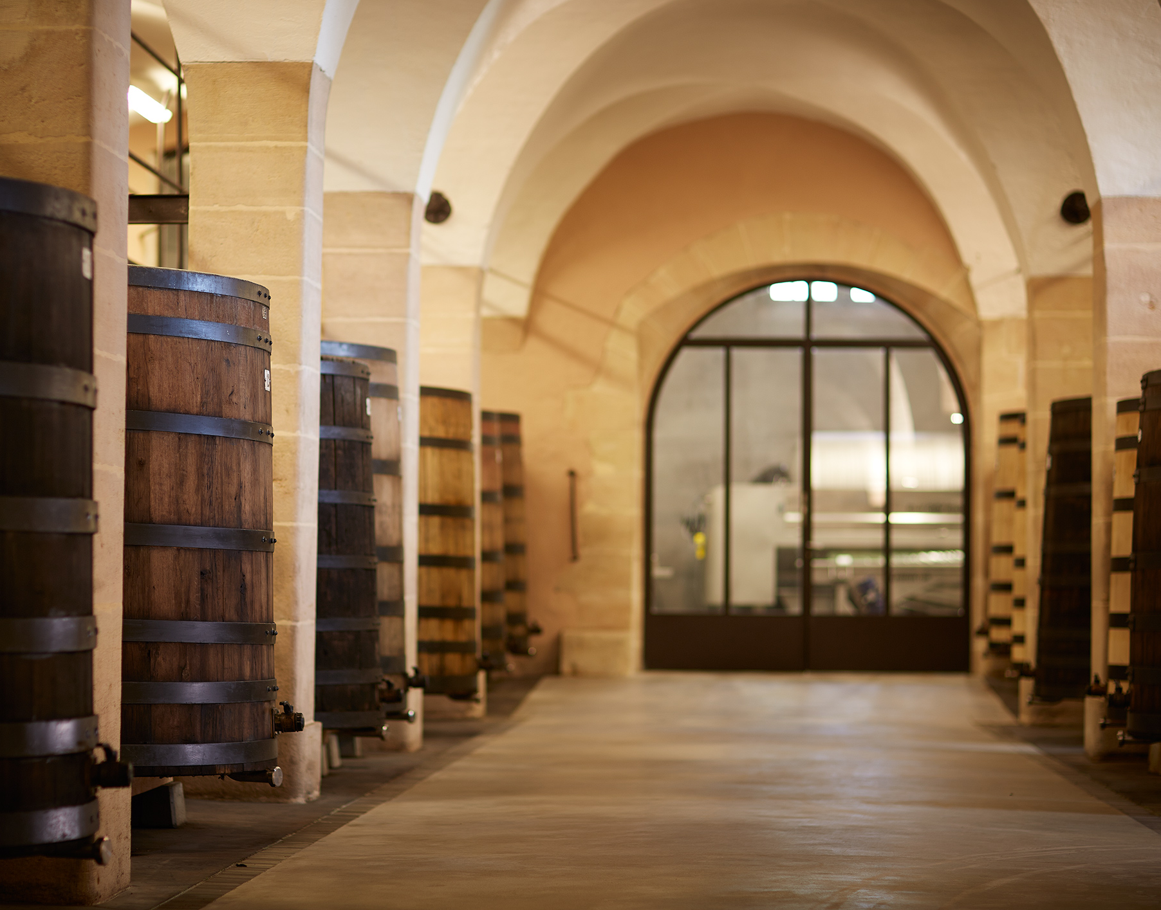
Tradition - Louis Latour Family
Maison Louis Latour – General Presentation
Tradition
Louis Latour Family
Founded in 1797 Maison Louis Latour’s origins stretch as far back as 1768 in the village of Aloxe-Corton
We are one of the last few truly independent Burgundy brands remaining
Louis-Fabrice Latour is the 11th generation to run and manage the Maison since its foundation
Corton-Charlemagne and Château Corton Grancey are the flagship wines of Maison Latour
Family responsibilities extended through time to the Hospices de Beaune, BIVB, FEVS
Notes:
On the middle South-eastern Segment (Aloxe), the wines are richer and have more power due to the more favorable orientation.
It’s the same thing at Pernand-Vergelessesbut. But, the forest on the upper-slope of Corton protect vines against Northeast wind ! At Pernand-Vergelesses, no forest, so the vines on the upper-slope have some difficulties to ripe (it’s why, we find here Village anf no Premier Cru).

Slide 20
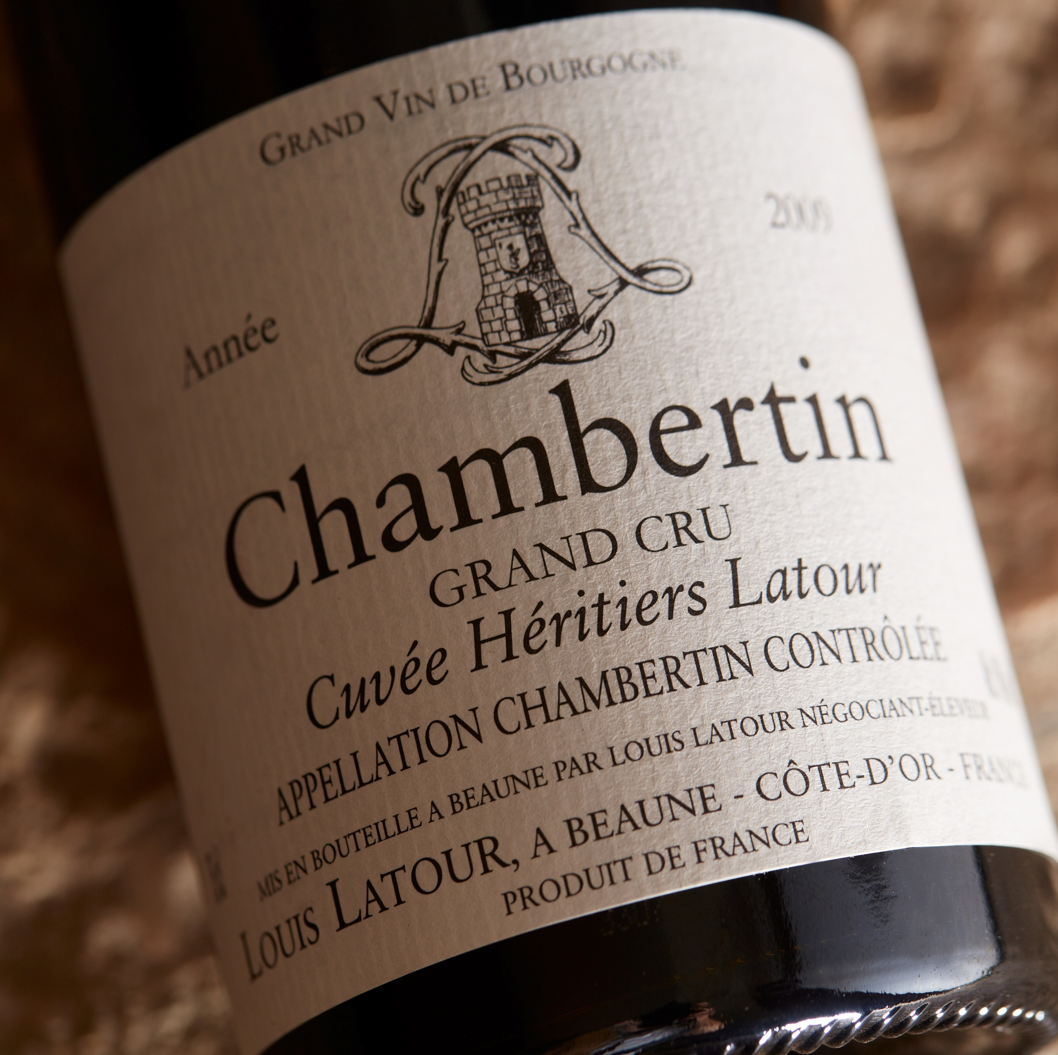
Tradition - Our Wines
Maison Louis Latour – General Presentation
Tradition
Our Wines
We produce over 130 appellations with high standards of quality
Modern infrastructures and traditional winemaking, using gravity-fed vinification
Short and intense cuvaison
Our reds are elegant with smooth tannins and finesse
Our whites are structured, rich and well balanced
Powerful with some acidity
« Elegance and balance are the keywords that have always
outlined the vinification practice of Maison Latour. ».
Louis-Fabrice Latour

Slide 21
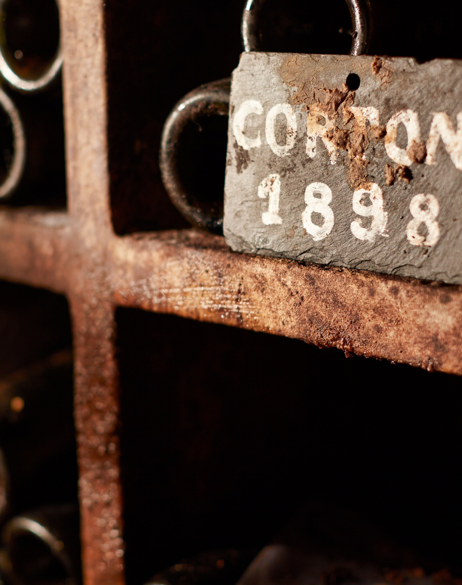
Tradition - Our Domaines Wines
Maison Louis Latour – General Presentation
Tradition
Our Grand Cru Wines
Rouge
Corton Bressandes | 3.03 hectares | 7.58 acres
Corton Les Chaumes | 1.29 hectares | 3.2 acres
Corton Clos de la Vigne au Saint | 2.50 hectares | 6.25 acres
Corton Les Perrières | 4.32 hectares | 10.7 acres
Corton Clos du Roi | 1.75 hectares | 4.3 acres
Corton Les Grèves | 1.2 hectares | 3 acres
Chambertin Cuvée Héritiers Latour | 0.81 hectares | 2 acres
Romanée-St-Vivant Les Quatre Journaux | 0.76 hectares | 1.9 acres
Blanc
Corton Charlemagne Grand Cru | 10.5 hectares | 25.4 acres
Chevalier Montrachet Les Demoiselles Grand Cru | 0.51 hectares | 1.48 acres

Slide 22
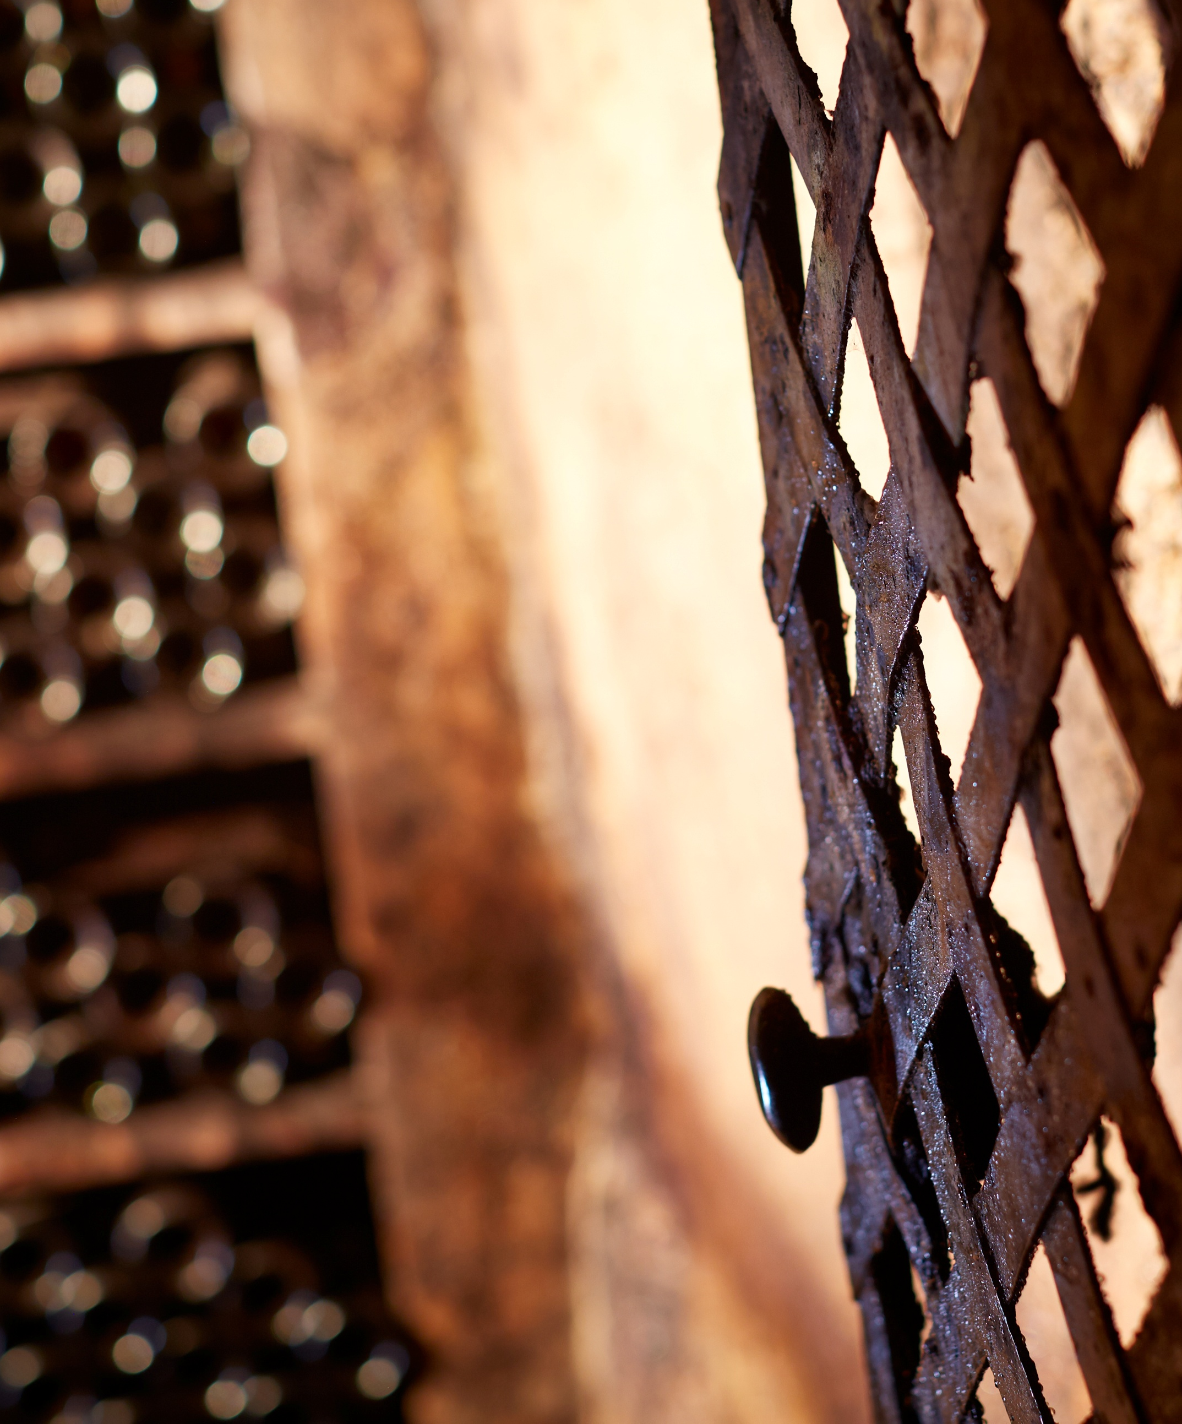
Tradition - Our Domaines Wines
Maison Louis Latour – General Presentation
Tradition
Our Villages and Premier Cru Wines
Rouge
Aloxe-Corton 1er Cru “Les Chaillots” | 5 hectares | 12.5 acres
Aloxe-Corton 1er Cru “Les Guérets” | 0.4 hectares | 1 acre
Aloxe-Corton Village | 3.15 hectares | 7.9 acres
Beaune 1er Cru “Vignes Franches” | 2.76 hectares | 6.9 acres
Beaune 1er Cru “Perrières” | 1.32 hectares | 3.28 acres
Beaune 1er Cru Clos du Roi” | 0.42 hectares | 1.05 acres
Beaune 1er Cru “Grèves” | 0.2 hectares | 0.5 acres
Pernand-Vergelesses 1er Cru “Ile des Vergelesses” | 0.75 hectares | 1.88 acres
Pernand Vergelesses | 0.44 hectares | 1.08 acres
Pommard 1er Cru “Epenots” | 0.41 hectares | 1 acre
Volnay 1er Cru “Les Mitans” | 0.27 hectares | 0.68 acres
Volnay | 0.47 hectares | 1.23 acres
Blanc
Beaune 1er Cru « Grèves » | 0.18 hectares | 0.4 acres
Beaune 1er Cru “Aux Cras” | 0.54 hectares | 1.35 acres
Pernand-Vergelesses 1er Cru « En Caradeux » | 1.58 hectares | 3.9 acres

Slide 23
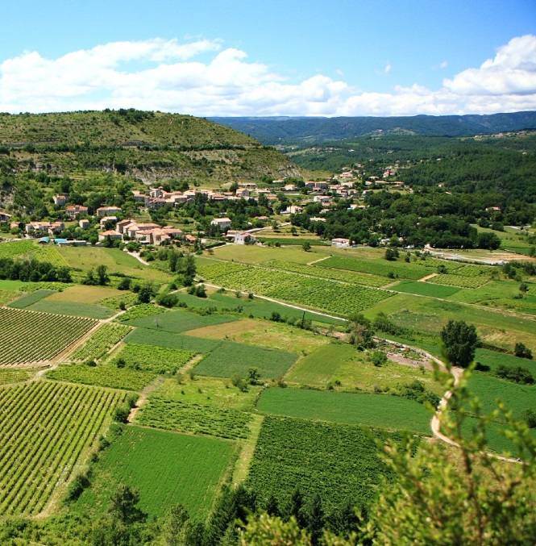
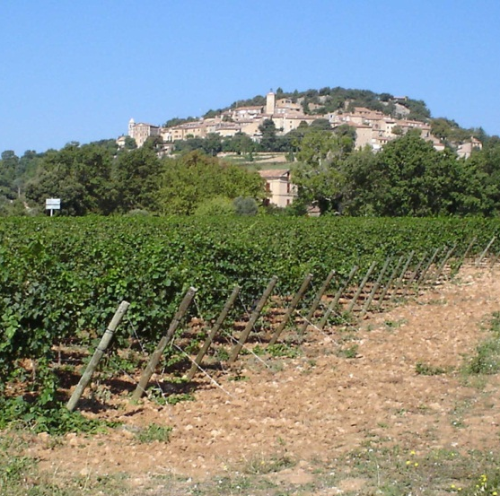
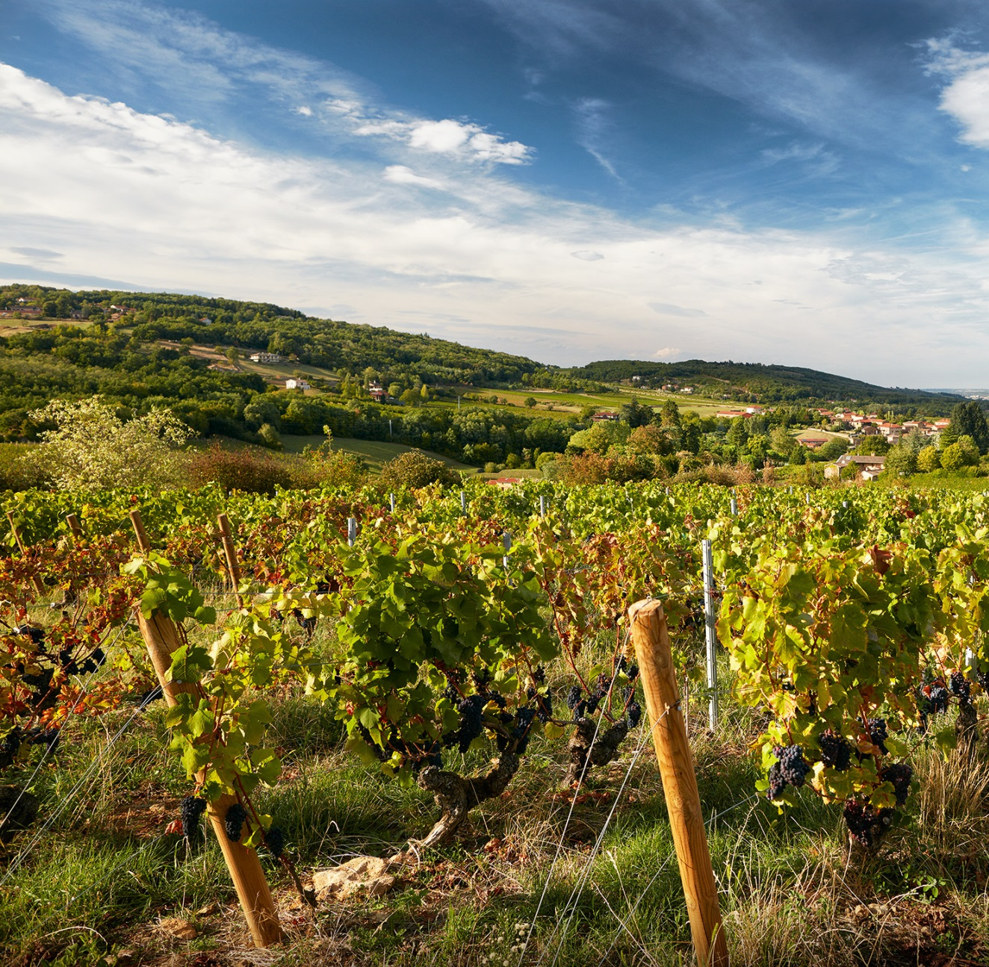
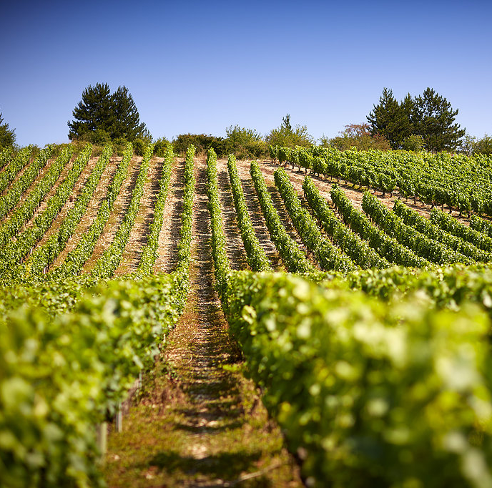
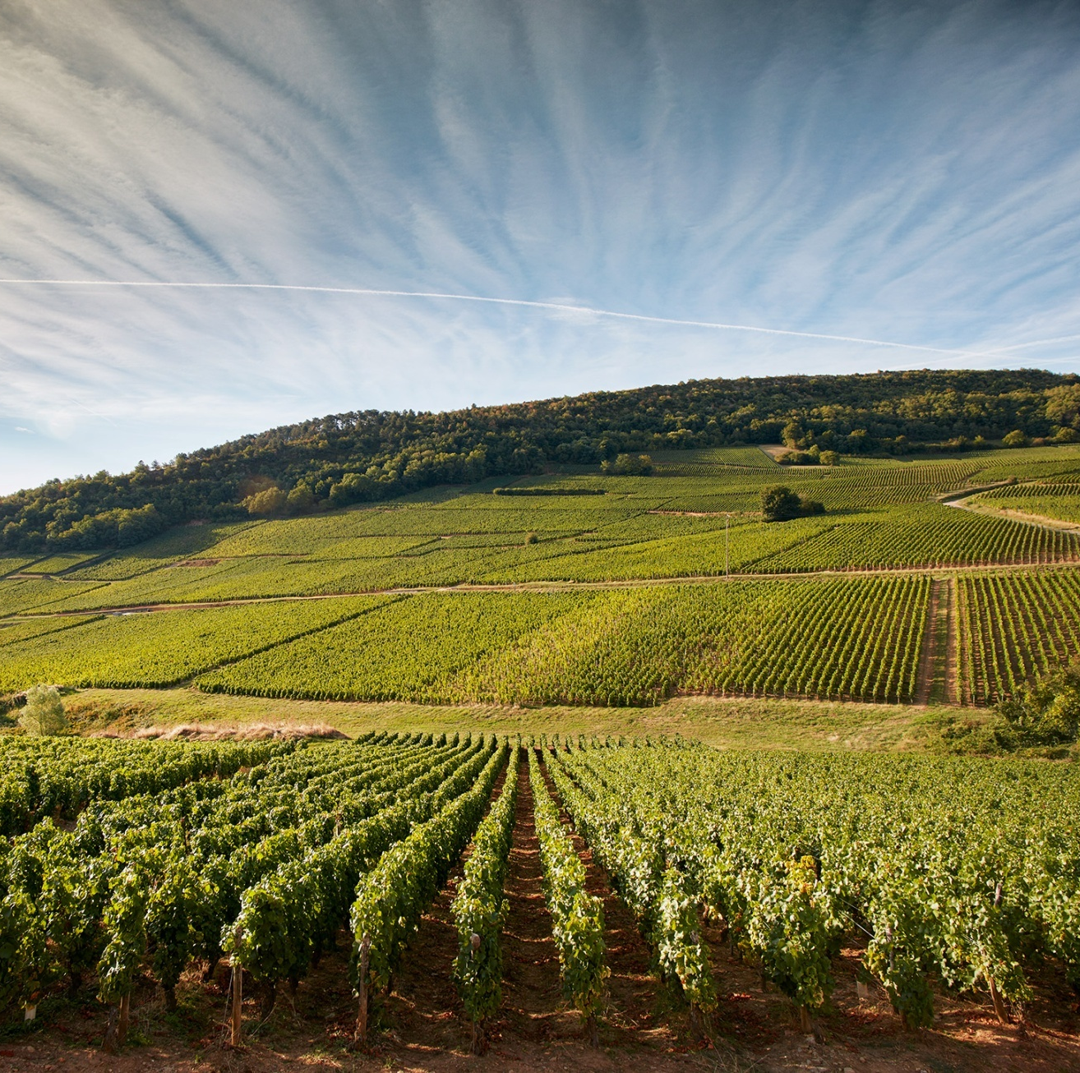
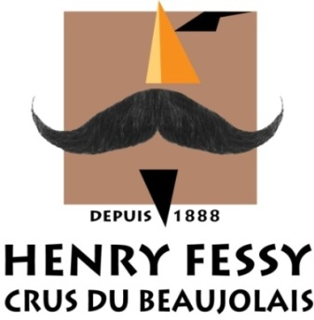
Innovation
Maison Louis Latour – General Presentation
Innovation
Ardèche,
1979
Domaine de Valmoissine,1989 (Var)
Les Pierres Dorées
2016
Investments outside Burgundy:
Ardèche and Domaine de Valmoissine
Investments in Greater Burgundy:
Simonnet Febvre, Henry Fessy and les Pierres Dorées
Simonnet-Febvre,
2003 (Chablis)
Henry Fessy,
2008 (Beaujolais)

Slide 24
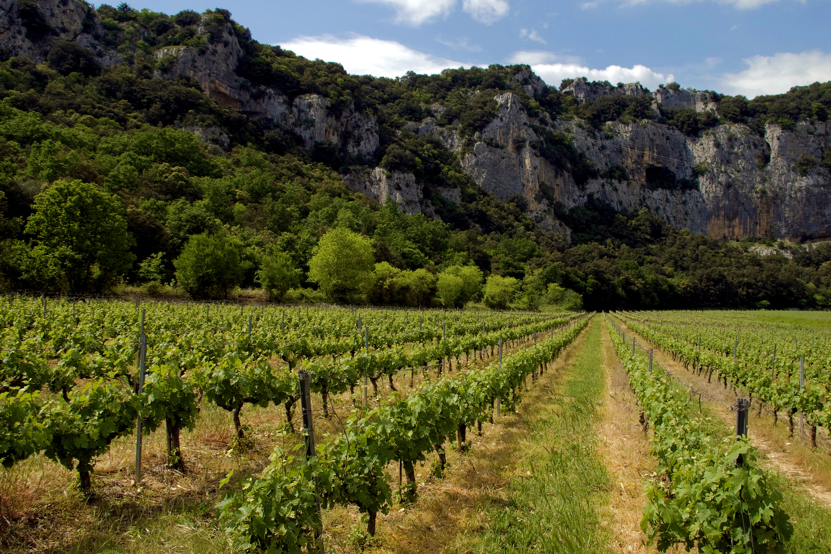
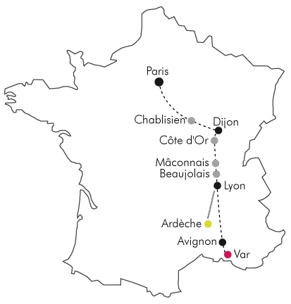
Innovation - Ardèche
Maison Louis Latour – General Presentation
Ardèche
Chardonnay
Southern France
(West of the Rhone Valley)
Investment since 1979
An ideal climate for early
ripening
Clay-chalk soils, similar to Burgundy
Partnership with local growers
(320 ha / 800 acres)
High tech winery built on site in1986
Ardèche – Grand Ardèche – Viogner – Duet
Indication Géographique Protégée (IGP) Ardèche

Slide 25
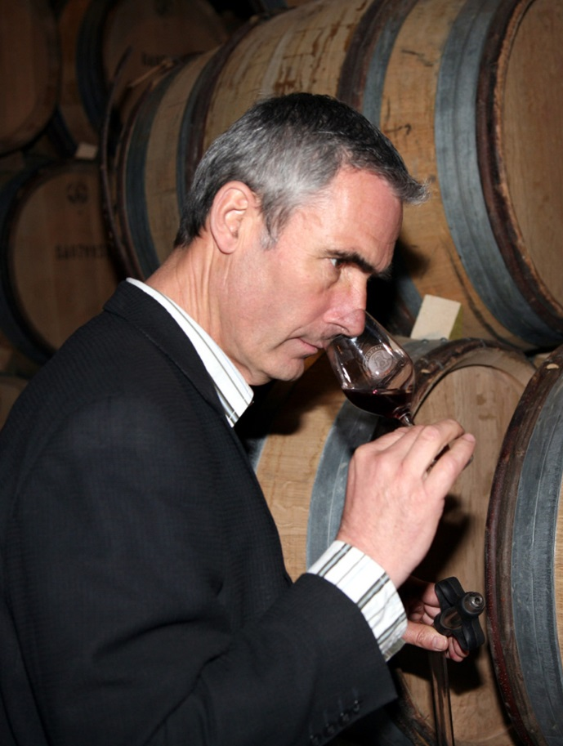
Innovation - Domaine de Valmoissine
Maison Louis Latour – General Presentation
Domaine de Valmoissine
Pinot Noir
Alain Berthon,
Ardèche Winemaker
South of France (between
St-Tropez and Draguignan)
Investment since 1989
Ideal climate: hot days, cold nights
Perfect soils & exposure at altitude (500m)
100 ha / 247 acres of vineyard
Hand harvested
Indication Géographique Protégée (IGP) Var

Slide 26
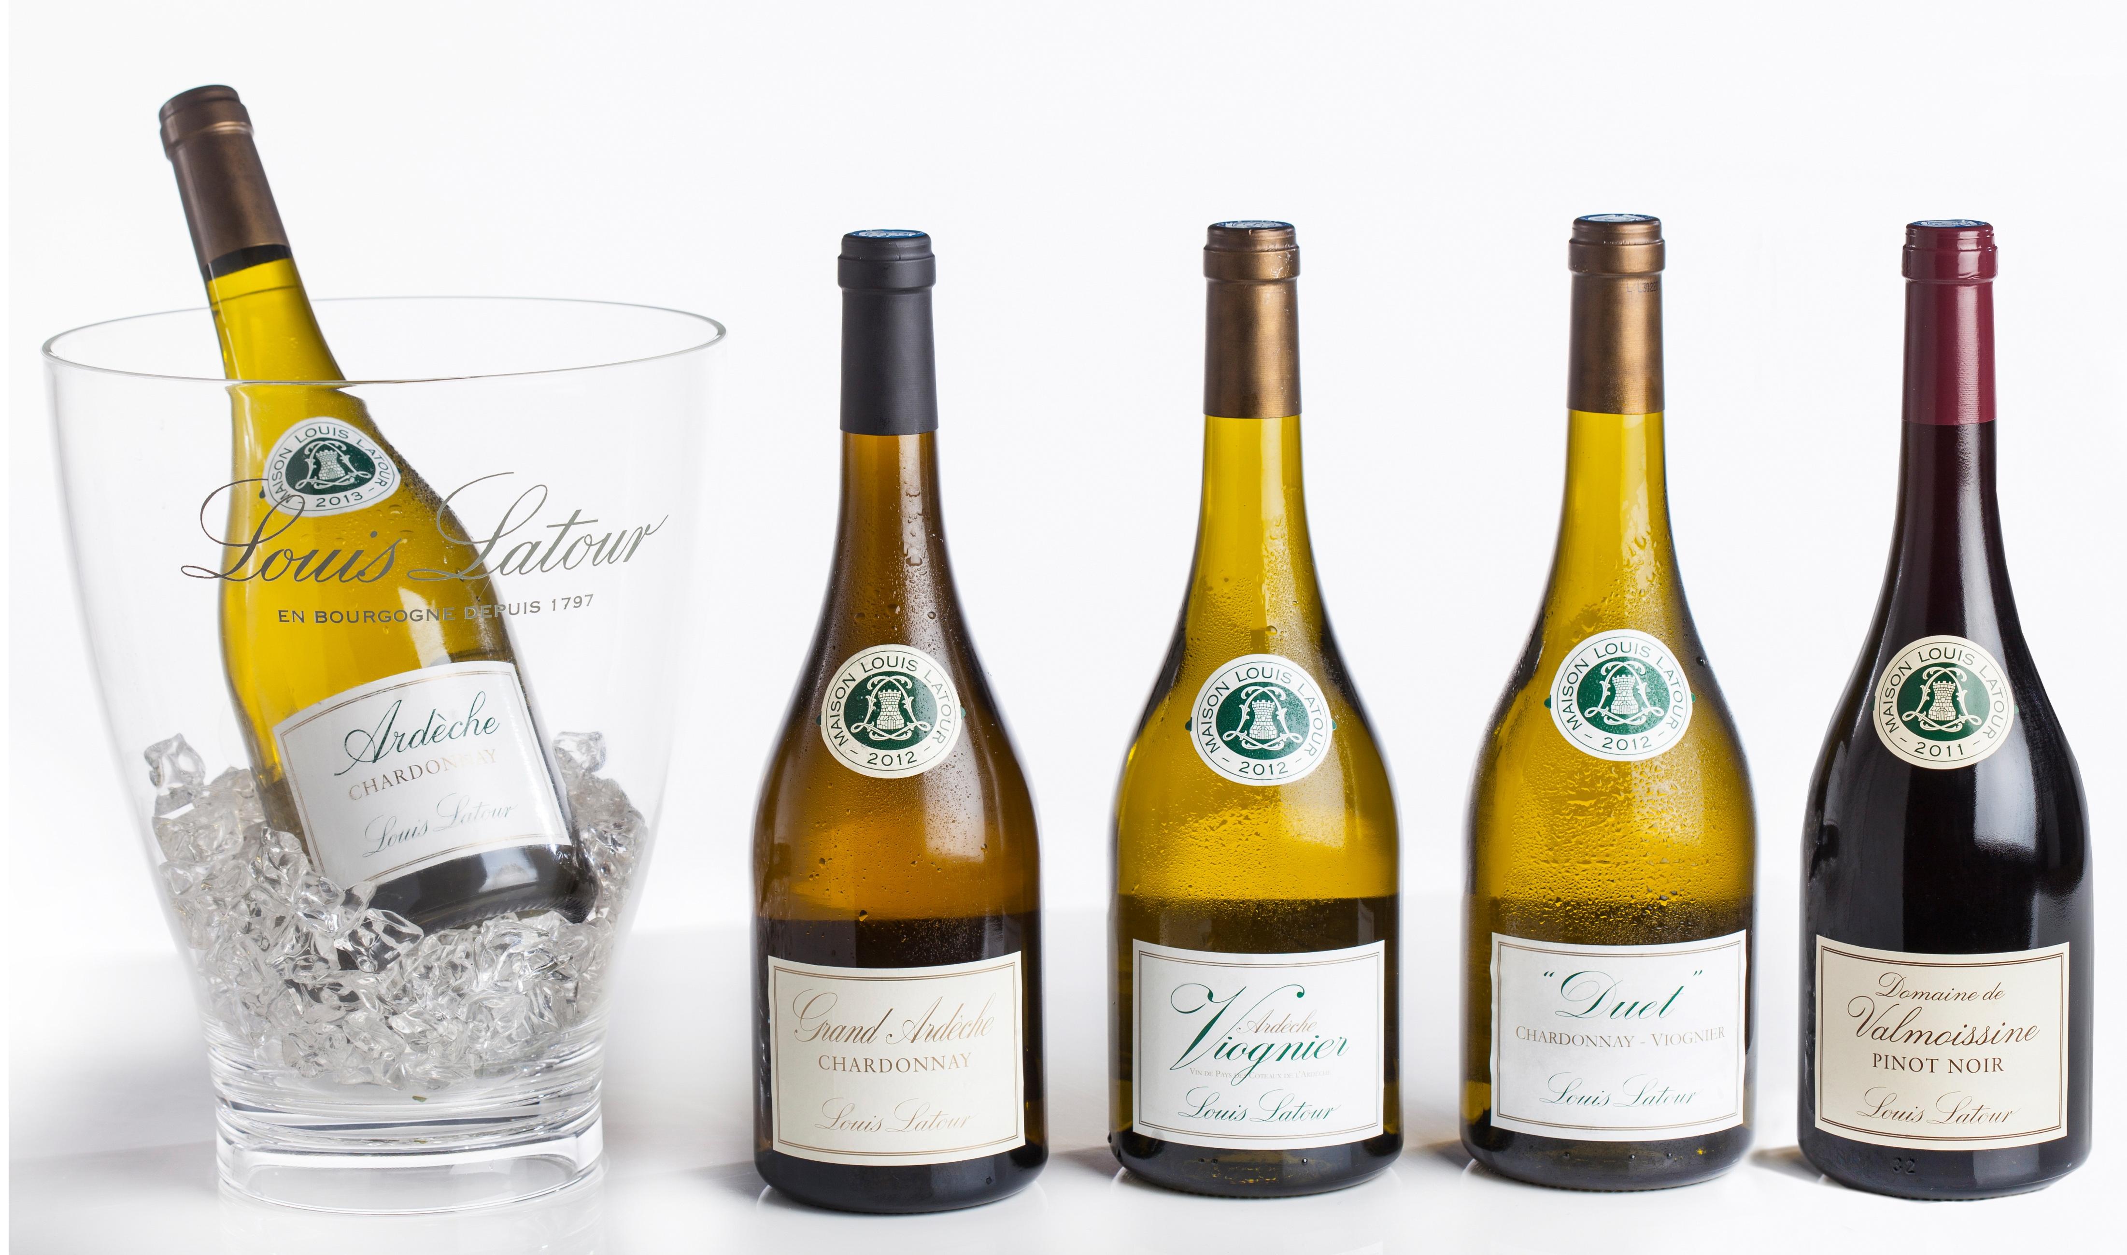
Innovation - Ardèche
Maison Louis Latour – General Presentation
Ardèche &
Valmoissine
Chardonnay, Pinot Noir, Viognier
Since 1979

Slide 27
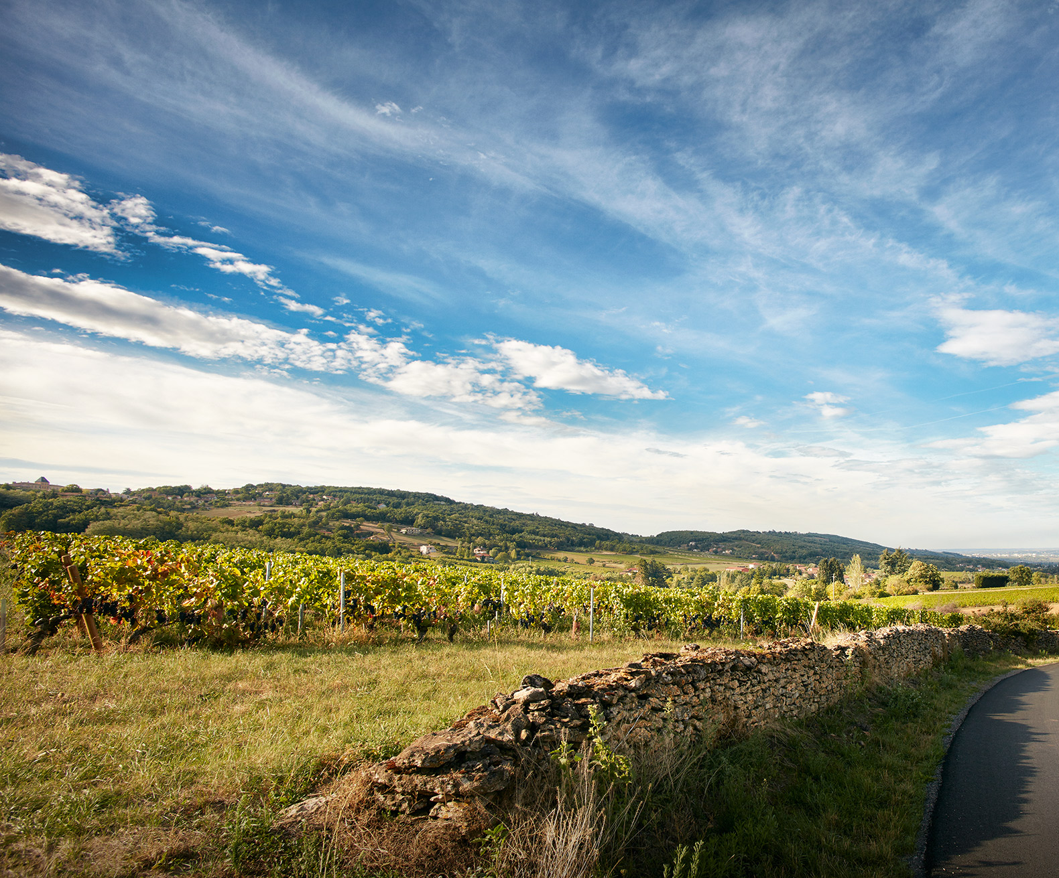
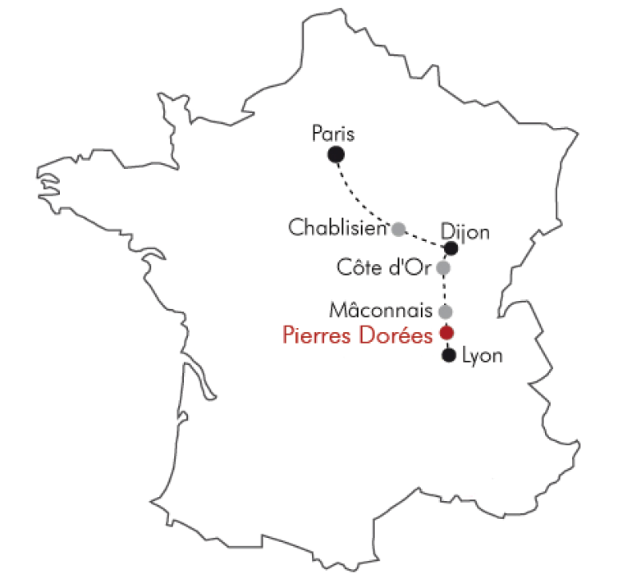
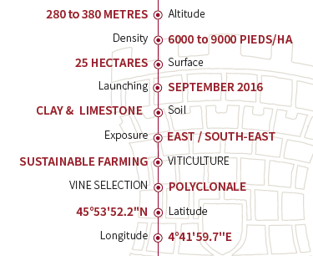
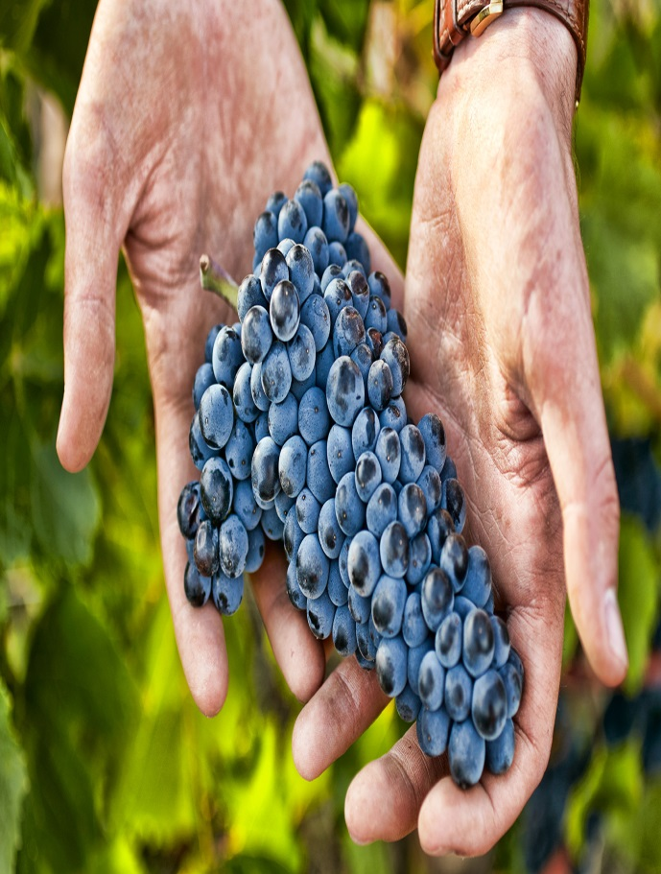
Innovation – Les Pierres Dorées
Maison Louis Latour – General Presentation
Les Pierres Dorées
Pinot Noir
All the conditions to create great wines are united in the Pierres Dorées vineyard. Hard work was necessary to replant over 20 hectares; starting with, the thorough selection of the Pinot Noir stock, from the Burgundy Wine-making Technical Association.
We have chosen to work with a slightly lower planting density compared to our vines in Côte d’Or (North of Burgundy): 9000 vine stocks per hectare; semi widely spaced vines which resemble the vineyards from Alsace and St Émilion.

Slide 28
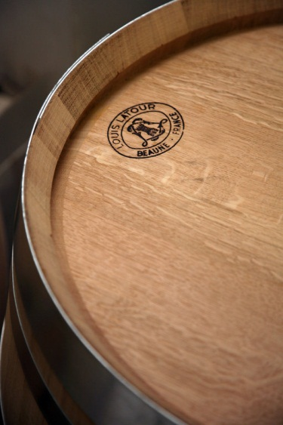
Perfection
Maison Louis Latour – General Presentation
Perfection
A high standard of quality: in the vineyards, in the winemaking, in production and throughout distribution…
Sustainable farming since the1980s
An extensive Burgundy range from our three wineries:
Louis Latour, Simonnet-Febvre and Henry Fessy
Vertical Integration – cooperage, lab, print shop
Louis-Fabrice Latour
“ We look to the past to imagine the future.”
“ We raise our glasses: to Louis Latour, a great firm with a great
past and a great future.”
Michael Broadbent, Christie’s, London

Slide 29
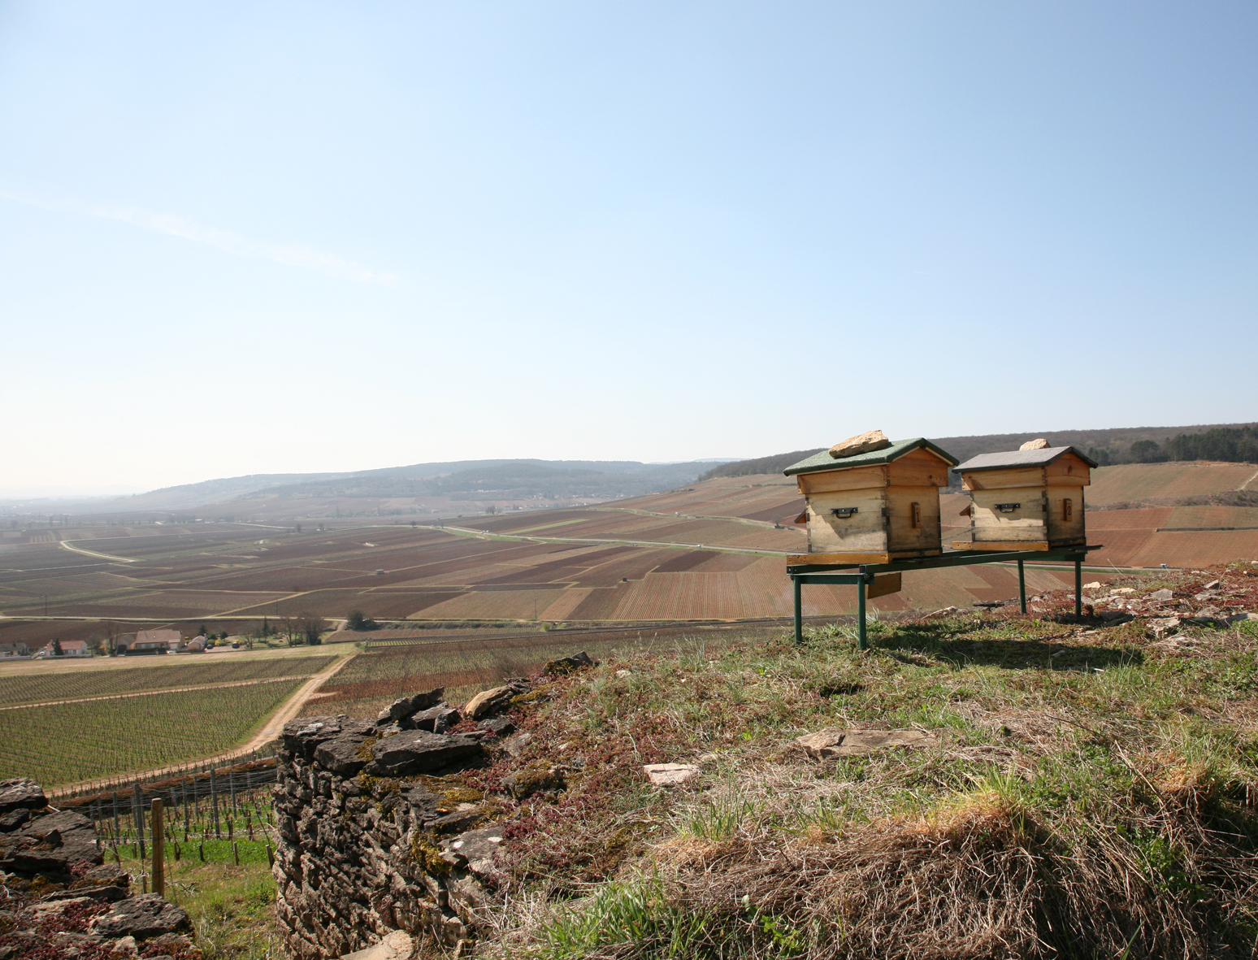
Perfection - Sustainable Farming
Maison Louis Latour – General Presentation
Sustainable farming
Since 1989
Attentive to the ecosystem as a whole
Vineyards under ISO14001 certified by FARRE
A strong policy of reducing treatments
In depth study of climate and its consequences
More global initiatives:
Paysage de Corton (2009): to address the problems of erosion and environmental protection.

Slide 30
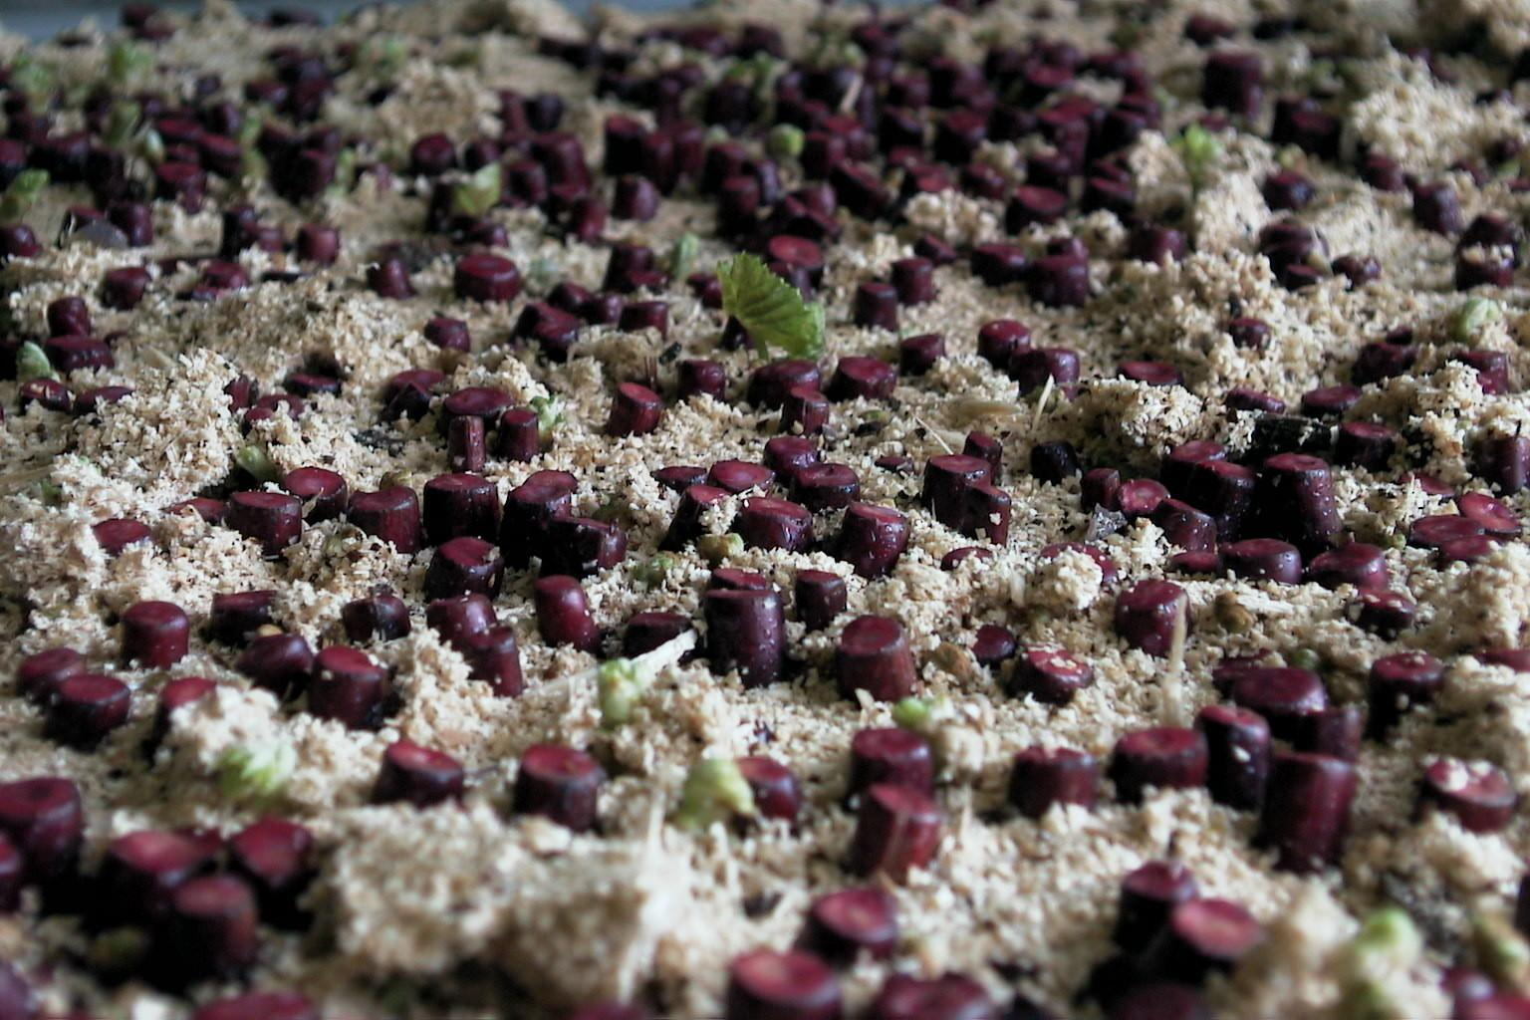
Vine-Growing
Maison Louis Latour – General Presentation
Vine Selection
Selection & Nursury
Pinot being an old variety, it presents an important diversity, Pinot Fins = smaller cluster with intense color and flavors.
Today 99% of worldwide plantation are clonal (selected) plants. At Domaine Louis Latour we are using Burgundy massale (field) selection (ATVB).
In 2008 Louis Latour and DRC created the “Fondation du Pinot Noir", an association of the best producers working together to select Pinot Fins in old vineyards. The resulting vines will be planted in 2020, this is working for the future!
Notes:
Pinot Noir: field selection on Rootstock Rupestris/Berlandierie
161-49 -> Low vigor resistant to limestone
Chardonnay clones: N° 76,95 (small production, renforce la minéralité)

Slide 31
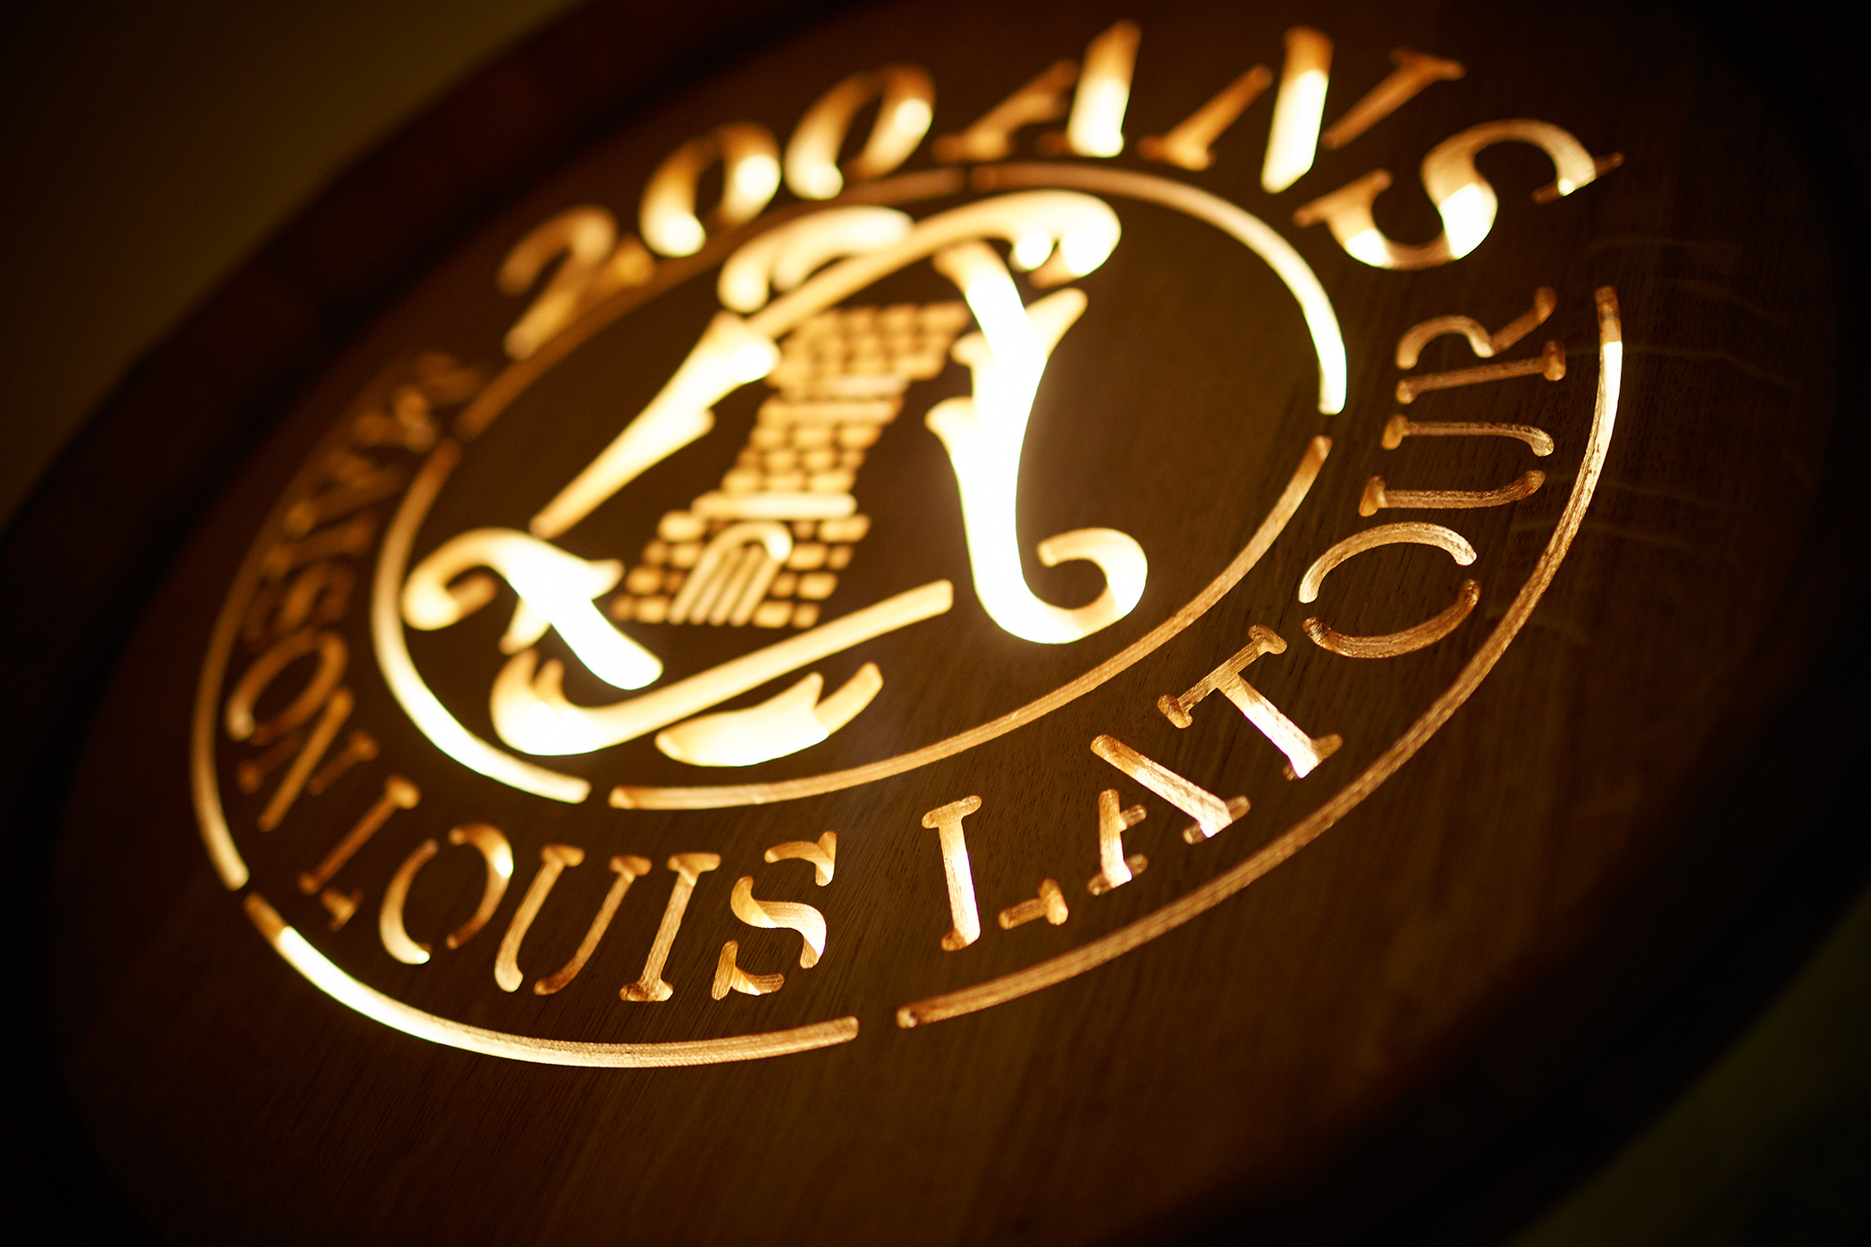
Louis Latour in 9 points
Maison Louis Latour – General Presentation
Louis Latour in 9 points
Still family-owned and run
The largest Domaine of Grands Crus
One of the most highly respected brands
Innovative farming & environmental protection
A successful global export market
Pioneer in varietal wines & Greater Burgundy development
Renowned for the quality of our reds and whites
An extensive range of Burgundies
Our own cooperage

Slide 32
Louis Latour
Maison Louis Latour – General Presentation
“ We raise our glasses to Louis Latour, a great firm
with a great past and a great future.”
Michael Broadbent, Christie’s, London

